Slide 1
Chapter 13
Principles of Pharmacology and Pharmacokinetics
Notes:
Chapter 13: Principles of Pharmacology
Comprehensive Lecture

Slide 2

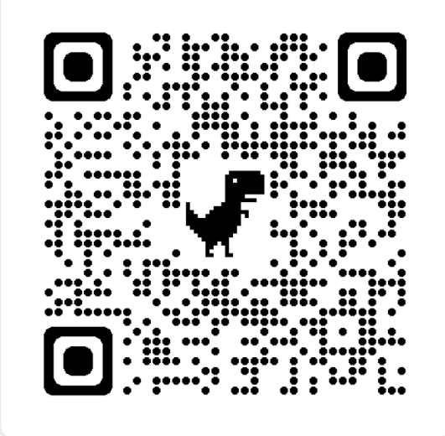
Please take a picture.
Erica Warkus
Erica.Warkus@gmail.com
Second year Emergency Medicine resident at SMH
From Hawaii
Archery
Dogs > cats
Lecture slides available at:
EMWRaP.org/ems-lecture/ or →

Slide 3

Erica’s Lecture Key
This will not be on your test (This is Erica’s slide)
Highlights: This seems like a Vocab word
Outside my bubble – Priorities!
Probably not on our agenda today
X -------------------------
Outside my bubble. Please read up!
Notes:
National EMS Education Standard Competencies
Pharmacology
Integrates comprehensive knowledge of pharmacology to formulate a treatment plan intended to mitigate emergencies and improve the overall health of the patient.

Slide 4
National EMS Education Standard Competencies
Pharmacology :
Integrates comprehensive knowledge of pharmacology to formulate a treatment plan intended to mitigate emergencies and improve the overall health of the patient.
Notes:
National EMS Education Standard Competencies
Pharmacology
Integrates comprehensive knowledge of pharmacology to formulate a treatment plan intended to mitigate emergencies and improve the overall health of the patient.

Slide 5
National EMS Education Standard Competencies
Study of Pharmacology – Your goals:
Integrates comprehensive knowledge of pharmacology
to formulate a treatment plan
intended to mitigate emergencies
and improve the overall health of the patient.
← Working on this now
Notes:
National EMS Education Standard Competencies
Pharmacology
Integrates comprehensive knowledge of pharmacology to formulate a treatment plan intended to mitigate emergencies and improve the overall health of the patient.

Slide 6
National EMS Education Standard Competencies
Principles of Pharmacology
Medication safety
Medication legislation
Naming
Classifications
Schedules
Pharmacokinetics
Storage and security
X -------------------------
X -------------------------
X -------------------------
X -------------------------
Notes:
National EMS Education Standard Competencies
Principles of Pharmacology
Medication safety (pp 628, 647-650)
Medication legislation (pp 622-623)
Naming (p 625)
Classifications (pp 623, 627)
Schedules (p 623)
Pharmacokinetics (p 641)
Storage and security (pp 627-628)

Slide 7
National EMS Education Standard Competencies
Principles of Pharmacology (cont’d)
Autonomic pharmacology
Metabolism and excretion
Phases of medication activity
Medication response relationships
Medication interactions
Toxicity
X -------------------------
X -------------------------
X -------------------------
X -------------------------
Notes:
National EMS Education Standard Competencies
Autonomic pharmacology (pp 649-653)
Metabolism and excretion (pp 646-647)
Mechanism of action (pp 626-631)
Phases of medication activity (pp 646-647)
Medication response relationships (pp 630-631, 635-639)
Medication interactions (pp 639-640)
Toxicity (pp 628, 636-638)

Slide 8
National EMS Education Standard Competencies
Medication Administration
Routes of administration
Self-administer medication
Peer-administer medication
Assist/administer medications to a patient
Within the scope of practice, administer
medications to a patient
Notes:
National EMS Education Standard Competencies
Medication Administration
Routes of administration (pp 641-644)
Self-administer medication (see Chapter 14, Medication Administration)
Peer-administer medication (see Chapter 14, Medication Administration)
Assist/administer medications to a patient (see Chapter 14, Medication Administration)
Within the scope of practice of the paramedic, administer medications to a patient (pp 648-649, and see Chapter 14, Medication Administration)

Slide 9



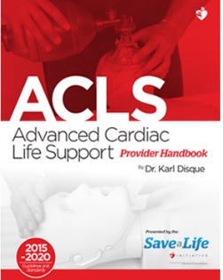



What is an algorithm?
If this ______, then that ______.
Simplifies decision making
Prioritizes action
Clarifies roles
???
A B C
A B C

Slide 10





Why?
Consistency
Trial and error
Efficiency
Teachability

Slide 11
National EMS Education Standard Competencies
Study of Pharmacology – Your goals:
Integrates comprehensive knowledge of pharmacology
to formulate a treatment plan
intended to mitigate emergencies
and improve the overall health of the patient.
Notes:
National EMS Education Standard Competencies
Pharmacology
Integrates comprehensive knowledge of pharmacology to formulate a treatment plan intended to mitigate emergencies and improve the overall health of the patient.

Slide 12
Build your algorithm
Define your priorities
Understand WHY
Create your framework
Revise and reflect

Slide 13
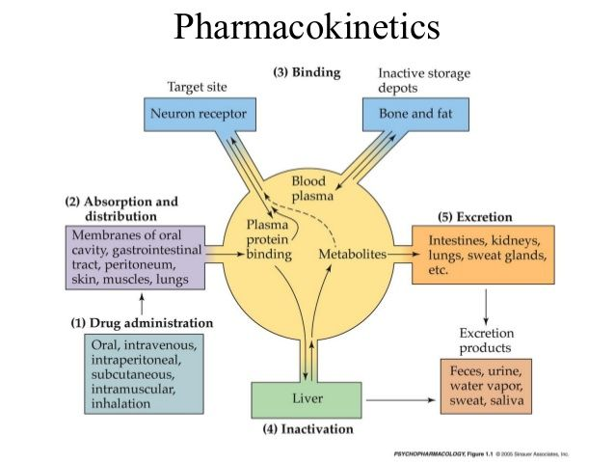
Pharmacokintetics

Slide 14
Someday, you will make a mistake
…Hundreds of them, actually.

Slide 15
Why do we give medications?
Improve the overall health of the patient
Address immediately life-threatening situations
NOT… because we wanted to do something
“Above all: Do no harm.”

Slide 16
Introduction
Medication administration is a defining element of paramedic clinical practice.
Medications can:
  Correct or decrease the severity of an illness or injury
  Manage life-threatening conditions
  Substantially reduce patient discomfort
Notes:
Lecture Outline
I. Introduction
A. A defining element of paramedic clinical practice
B. Medication can:
1. Correct or decrease the severity of an illness or injury
2. Manage life-threatening conditions
3. Substantially reduce patient discomfort

Slide 17
Introduction
Severe, often life-threatening consequences can occur if paramedics make a mistake.
How do mistakes happen?
  Wrong medicine
  Wrong route
  Wrong dose
  Wrong technique
  Wrong patient
Notes:
Lecture Outline
C. Severe, often life-threatening consequences if paramedics
1. Administer the wrong medication
2. Administer medication via the wrong route
3. Administer the incorrect dose
4. Fail to follow the correct technique for administration
D. Pharmacology: the scientific study of how various substances interact with or alter the function of living organisms
1. Used in a variety of ways
a. Treating patients who already receive medications
b. Treating patients who have been exposed to a potentially toxic chemical, drug, or medication
c. Administering medications to treat patient symptoms

Slide 18

To Err is human…
To forgive is divine.
High Risk, high reward careers
Gratitude for the privilege we have.
Some of your patients will die.
  Learn to forgive yourself.

Slide 19
How can you minimize errors?
Foundation of knowledge
Use your algorithms
Continue learning, revising, improving
If it doesn’t make sense, figure out why

Slide 20
“Don’t just do something, stand there.”
~ Medical school attending

Slide 21
Reducing Medication Errors
Medication decisions are often based on memory and frequently occur in the context of a stressful, life-threatening situation.
  Paramedics could make a cognitive or technical error.
Notes:
Lecture Outline
VI. Reducing Medication Errors
A. Medication decisions are often based on memory and frequently occur in the context of a stressful, life-threatening patient situation.
1. Paramedics are constantly at risk for a cognitive error or a technical error.

Slide 22
Reducing Medication Errors
Right assessment
Right to refuse
Right evaluation
Right patient education
Right patient
Right medication
Right dose
Right route
Right time
Right documentation and reporting
Notes:
Lecture Outline
The ten rights of medication administration are:
(1) Right patient
(2) Right medication
(3) Right dose
(4) Right route
(5) Right time
(6) Right documentation and reporting
(7) Right assessment
(8) Right to refuse
(9) Right evaluation
(10) Right patient education

Slide 23
Reducing Medication Errors
Perform a verbal read-back of orders.
Call out medication name and dose.
Label syringes.
Bring along the patient’s home medications.
Use a reliable reference source.
Have a partner confirm the dose.
Outside my bubble. Please read up!
Notes:
Lecture Outline
2. Perform a verbal read-back of any orders received from online medical control.
3. Call out the medication name and dose prior to administration.
4. Unlabeled syringes pose a significant hazard in healthcare.
a. Whenever possible, use premade stickers or hand-written labels that indicate at least the medication’s name and concentration, even if the medication is intended to be administered immediately.
5. Patient safety experts recommend building an environment in which EMS providers feel comfortable reporting errors and near misses.
a. Often referred to as a “just culture”
6. Bring along a patient’s home medications when transporting the patient to a health care facility.
7. Use a reliable reference source when administering unfamiliar medications or when an unusual dose or route of administration is being considered.
8. Have a partner confirm the volume in a syringe or a weight-based medication calculation.
9. Evaluate the patient for medication allergy or hypersensitivity before each administration.
10. The Institute for Safe Medication Practices (IMSP) has developed a list of error-prone medication abbreviations.
a. When these are used, there is an increased likelihood of a medication error.

Slide 24
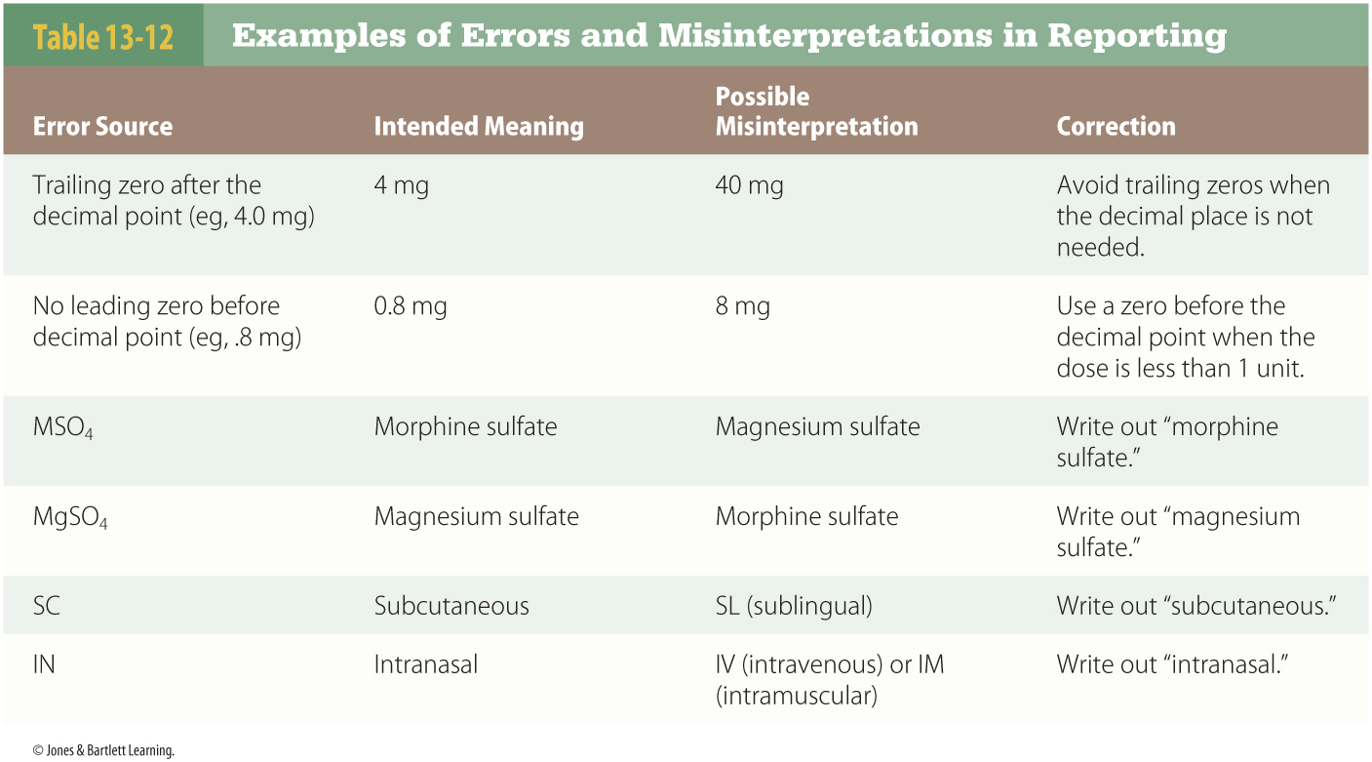
Reducing Medication Errors
Outside my bubble. Please read up!
Notes:
This table shows examples of possible errors and misinterpretations in reporting.

Slide 25
You have chosen to be a hero.
Burnout
Gratitude and humility
Purpose and insight
  Know your “WHY”
Take care of each other

Slide 26
Historical Perspective on Medication Administration
Chemicals from plants and animals have been used for centuries.
Formal scientific study began in the 17th and 18th centuries.
Some ancient remedies are still used today.
Outside my bubble. Please read up!
Notes:
Lecture Outline
II. Historical Perspective on Medication Administration
A. Chemicals derived from plants and animals have been used for centuries to cure disease or relieve symptoms.
1. Natural remedies were directed toward symptoms rather than the disease process.
2. Certain medications discovered in ancient times are still in use.
B. Formal scientific study of the effect of medications began in the late 17th and early 18th centuries.

Slide 27
Historical Perspective on Medication Administration
Evidence-based guidelines assist clinicians using pharmacologic interventions.
  Medications undergo extensive testing and clinical trials.
Outside my bubble. Please read up!
Notes:
Lecture Outline
C. The science of pharmacology has evolved into a highly pro­fitable and highly regulated industry.
1. Evidence-based guidelines assist clinicians using pharmacologic interventions.
2. Medications undergo extensive testing and clinical trials.
3. Adverse reactions are common.

Slide 28
Medication and Drug Regulation
The United States has a comprehensive system of medication and drug regulation.
  The Food, Drug, and Cosmetic Act (1938)
    US Food and Drug Administration (FDA) approves new medications and removes unsafe medications from use.
Outside my bubble. Please read up!
Notes:
Lecture Outline
III. Medication and Drug Regulation
A. Comprehensive U.S. system of medication and drug regulation
1. In 1906, the Pure Food and Drug Act prohibited altering or mislabeling medications.
2. In 1909, the Opium Exclusion Act prohibited importing opium.
3. In 1914, the Harrison Narcotic Act restricted the use of opiates and cocaine.
4. The Food, Drug, and Cosmetic Act (1938) gave the US Food and Drug Administration (FDA) enforcement authority for approving new medications and removing unsafe medications from use.

Slide 29
Medication and Drug Regulation
Approval of a new medication typically takes years.
  Some medications are used “off-label.”
    A purpose not approved by the FDA
    At doses different from the recommended doses
    By a route of administration not approved
Outside my bubble. Please read up!
Notes:
Lecture Outline
5. Approval of a new medication typically takes years.
a. Only a small fraction of medications submitted to the FDA are approved.
b. Some medications are used “off-label.”
i. A purpose not approved by the FDA
ii. At doses different from the recommended doses
iii. By a route of administration not approved by the FDA
iv. Common practice in healthcare
(a) Increases liability for the healthcare worker

Slide 30
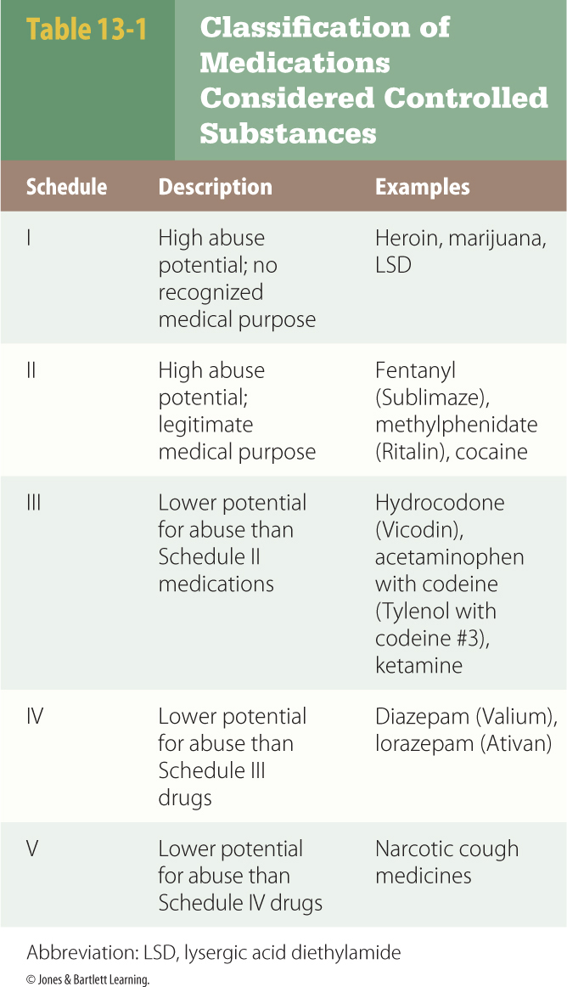
Controlled Substances Act of 1970
Classifies certain medications with the potential of abuse into five categories (schedules)
Outside my bubble. Please read up!
Notes:
Lecture Outline
6. Paramedics need to be familiar with the rules and regulations implemented under the Controlled Substances Act of 1970.
a. This act is also known as the Comprehensive Drug Abuse Prevention and Control Act.
b. It classifies certain mediations with the potential of abuse into five categories (schedules).
i. Schedule I: High abuse potential; no recognized medical purpose
ii. Schedule II: High abuse potential; legitimate medical purpose
iii. Schedule III: Lower potential for abuse than Schedule II mediations
iv. Schedule IV: Lower potential for abuse than Schedule III drugs
v. Schedule V: Lower potential for abuse than Schedule IV drugs
c. The US Drug Enforcement Agency is responsible for enforcing this act.
d. Schedule I medications may not be prescribed, dispensed, used, or administered for medical use.
i. Example: Marijuana (remains controversial and depends on the state)
e. Paramedics are likely to carry and administer Schedule II medications.
f. All Schedule II through V medications require:
i. Locked storage
ii. Significant record keeping
iii. Controlled wasting procedures

Slide 31
Sources of Medication
Plants, animals, minerals, microorganisms
Synthetic
  Made completely in a laboratory
Semisynthetic
  Made from chemicals derived from plant, animal, or mineral sources
  Chemically modified in a laboratory
Outside my bubble. Please read up!
Notes:
Lecture Outline
B. Sources of medication
1. Sources of medication include:
a. Plants
b. Animals
c. Minerals
d. Microorganisms (bacteria, fungi, mold)
2. Other medications may be:
a. Synthetic (made completely in a laboratory)
b. Semisynthetic (made from chemicals derived from plant, animal, or mineral sources that have been chemically modified in a laboratory)

Slide 32
Sources of Medication
Pharmaceutical companies control:
  Concentration
  Purity
  Preservatives
  Other ingredients
Medications must have a manufacturing lot number and expiration date.
Outside my bubble. Please read up!
Notes:
Lecture Outline
3. During manufacturing, pharmaceutical companies control the following:
a. Concentration
b. Purity
c. Preservatives
d. Other ingredients
4. The United States Pharmacopeia–National Formulary (USP-NF) provides information regarding the manufacturing details of medications.
5. Every medication must have a manufacturing lot number and expiration date.

Slide 33
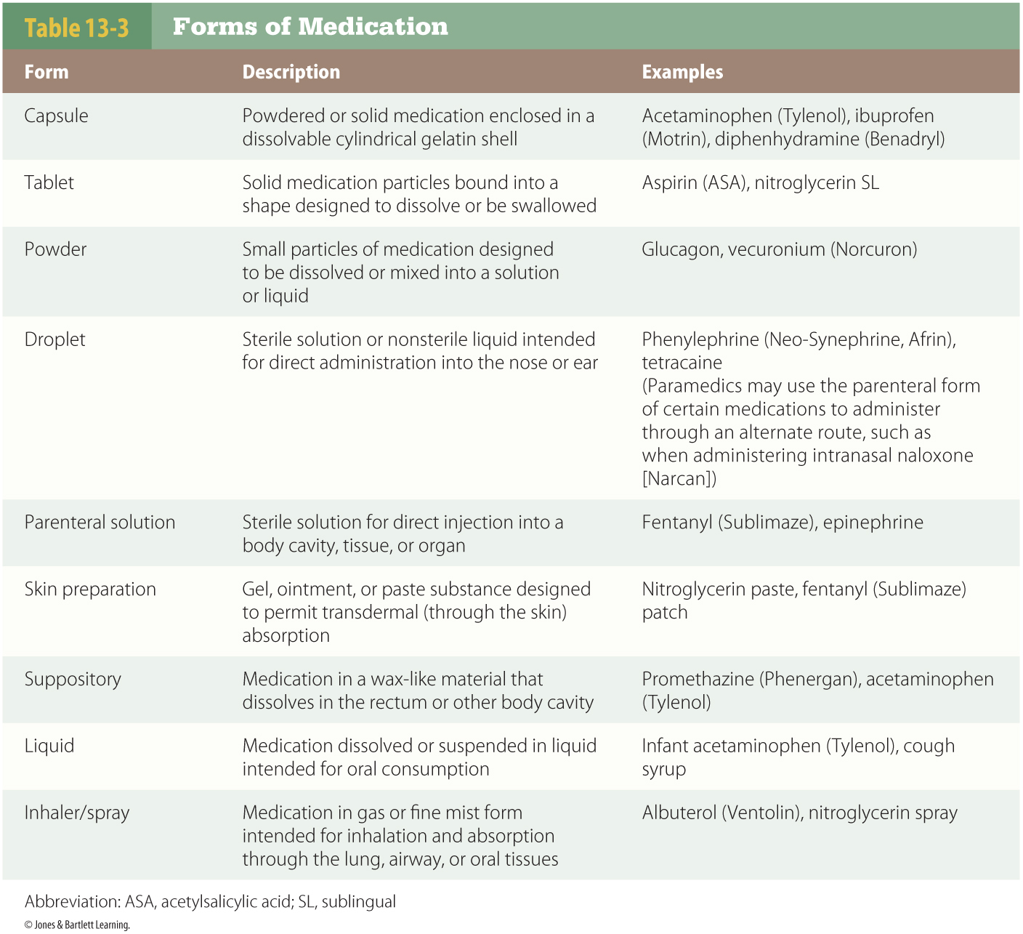
Forms of Medication
Notes:
Lecture Outline
C. Forms of medication
1. Most medications are administered as sterile injectable solutions.
a. Require careful handling and aseptic technique during administration
b. Supplied in:
i. IV bags
ii. Vials
iii. Ampules
iv. Glass bottles

Slide 34
Medication Names
Chemical name
  Used during development
Nonproprietary (generic) name
  Promotes consistency and avoids duplication
  Include a “stem”
Brand (proprietary) name
  Chosen by manufacturer
  Selected for marketing
Outside my bubble. Please read up!
Notes:
Lecture Outline
IV. Medication Management for Paramedics
A. Medication names
1. Medications in the United States have three distinct names.
a. Chemical name
i. Used during development
ii. Long and difficult to pronounce
iii. Rarely used in clinical practice
iv. Examples: sodium bicarbonate, potassium chloride
b. Nonproprietary (generic) name
i. Proposed by manufacturer
ii. Approved by US Adopted Names Council and World Health Organization
(a) Promotes consistency and avoids duplication
iii. Include a stem
(a) Links them to other medications in the same class (eg, midazolam, diazepam, and lorazepam)
(b) Not safe to rely entirely on the stem when attempting to determine the class of a medication
(1) Different classes may have the same stem.
c. Brand (proprietary) name
i. Chosen by the manufacturer and approved by the FDA
ii. Selected for marketing purposes

Slide 35
Medication Names
Example
  Chemical name: 4-chloro-N-furfuryl-5-sulfamoylanthranilic acid
  Generic name: furosemide
  Brand name: Lasix
“Tall man” lettering
  DiphenhydrAMINE and dimenhyDRINATE
Outside my bubble. Please read up!
Notes:
Lecture Outline
d. Example:
i. Chemical name: 4-chloro- N -furfuryl-5-sulfamoylanthranilic acid
ii. Generic name: furosemide
iii. Brand name: Lasix
2. Many reference sources use “tall man” lettering when printing names of certain medications.
a. Capitalized letters in medications with similar names
b. Example: DiphenhydrAMINE and dimenhyDRINATE

Slide 36
Medication Reference Sources
Consider:
  Reliability
  Printed, electronic, or both
  Depth of information
  Accessibility
  Cost
  Availability of updates
  Size of materials used
Outside my bubble. Please read up!
Notes:
Lecture Outline
B. Medication reference sources
1. When selecting a medication reference source, paramedics must consider:
a. Reliability
b. Whether source is printed, electronic, or both
c. Depth of information needed or provided
d. Accessibility
e. Cost
f. Availability of updates
g. Size of materials used

Slide 37
Medication Reference Sources
Medication monograph: medication profile
  USP-NF
  Physicians’ Desk Reference (PDR)
Outside my bubble. Please read up!
Notes:
Lecture Outline
2. A medication monograph is a medication profile.
a. Components include:
i. Medication names
ii. Category or class of medication
iii. Use/indication
iv. Mechanism of action
v. Pregnancy risk factor
vi. Contraindications
vii. Available forms
viii. Dosage
ix. Administration and monitoring considerations
x. Potential incompatibilities
xi. Adverse effects
xii. Pharmacokinetics
3. The USP-NF and Physicians’ Desk Reference (PDR) provide information about thousands of medications.
a. Size of printed versions makes these impractical in the prehospital setting.
b. Electronic versions may be helpful to EMS educators and administrators.

Slide 38
Medication Reference Sources
Manufacturers provide package inserts.
  Include information on:
    Dosing
    Route of administration
    Contraindications
    Adverse effects
Outside my bubble. Please read up!
Notes:
Lecture Outline
4. Manufacturers provide package inserts with every package of medication distributed.
a. Approved by FDA
b. Includes information on:
i. Dosing
ii. Route of administration
iii. Contraindications
iv. Adverse effects
v. Other characteristics

Slide 39
Medication Reference Sources
Hospital pharmacies often compile formularies specific to their needs.
AMA Drug Evaluations provides detail about medication selection and administration.
Notes:
Lecture Outline
5. Hospital pharmacies often compile medication information into formularies specific to the needs of specific hospitals.
6. The AMA Drug Evaluations is published by the American Medical Association.
a. Provides details about medication selection and administration
b. Not every medication in the compendium has received FDA approval.
7. Many choices are available for commercially published medication information references.
8. Many medication references can be accessed electronically.

Slide 40
What does evidence-based medicine mean?

Slide 41
AHA Classification
AHA classification of recommendations and level of evidence
  Class I—strong evidence supporting use
  Class IIa—moderate evidence
  Class IIb—weak evidence
  Class III—evidence does not support use
  Class indeterminate—beginning or continuing research; no recommendations yet
Notes:
Lecture Outline
C. AHA classification of recommendations and level of evidence
1. In most EMS settings, you will follow guidelines established and distributed by the American Heart Association (AHA).
a. These guidelines may be:
i. Referenced directly
ii. Incorporated into more extensive department or agency policies or protocols
b. The medications and interventions listed have varying degrees of support thorough reliable scientific evidence.
c. The AHA uses the following system to describe the relative importance of certain medications or interventions:
i. Class I indicates there is strong evidence supporting the use of the medication for the condition.
ii. Class IIa indicates moderate evidence.
iii. Class IIb indicates weak evidence.
iv. Class III indicates the evidence does not support that there is a benefit and may support that there is a harmful consequence.
v. Class indeterminate indicates either that research is beginning on a treatment or that research is continuing on a treatment; there are no recommendations until further research is performed (ie, cannot recommend for or against).

Slide 42
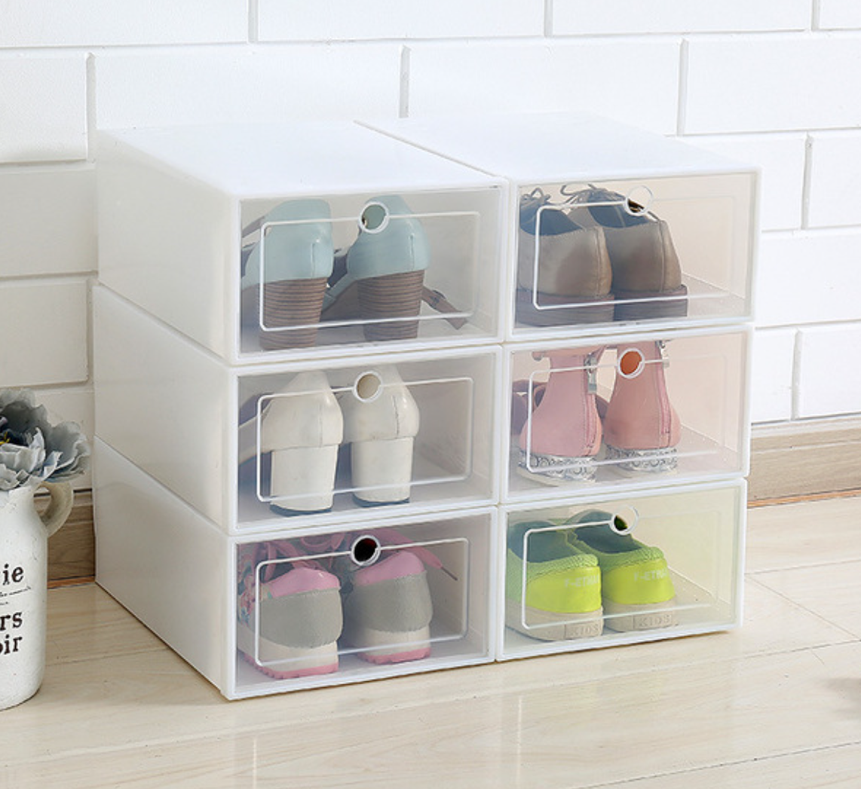
Medication Storage
Must provide adequate protection
Must be convenient for quick access
Must prevent physical damage
Should be placed in protective bins
Should facilitate quick and accurate identification
Outside my bubble. Please read up!
Notes:
Lecture Outline
D. Medication storage
1. Must be stored in a location that provides adequate protection but is convenient enough for quick access
2. Must be stored in a way that prevents physical damage to the medication or its container
a. May need to remove most of packaging
3. Should be placed in protective bins or surrounded by padding
4. Should be organized to facilitate quick and accurate identification

Slide 43


Medication Storage
Avoid:
  Direct sunlight
  Extreme temperatures
  Physical damage
Notes:
Lecture Outline
5. Avoid:
a. Direct sunlight
b. Extreme temperatures
c. Physical damage
6. Medication warmers or refrigerators for transport vehicles

Slide 44
Medication Security
Controlled substances require:
  Additional security
  Additional record keeping
  Disposal precautions
Outside my bubble. Please read up!
Notes:
Lecture Outline
E. Medication security
1. Controlled substances require additional security, record keeping, and disposal precautions.
a. Controlled substances must be in locked storage or continuously held by an on-duty EMS provider.
b. Disposal of partially used or damaged medication containers requires:
i. Verification by a witness
ii. Return of the damaged or unused portion to the department responsible for dispensing the medication
c. Regulations vary slightly from region to region.

Slide 45
Medication Security
Every last milliliter or milligram needs to be documented.
Controlled substances are often the target of tampering or diversion.
  Inspect vials and ampules.
Outside my bubble. Please read up!
Notes:
Lecture Outline
2. Every last milliliter or milligram needs to be documented from ordering to administration.
3. Controlled substances are often the target of tampering or diversion.
a. Inspect vials and ampules for signs of tampering.
b. Suspect tampering when appropriate doses of analgesic or sedative medications seem ineffective.

Slide 46
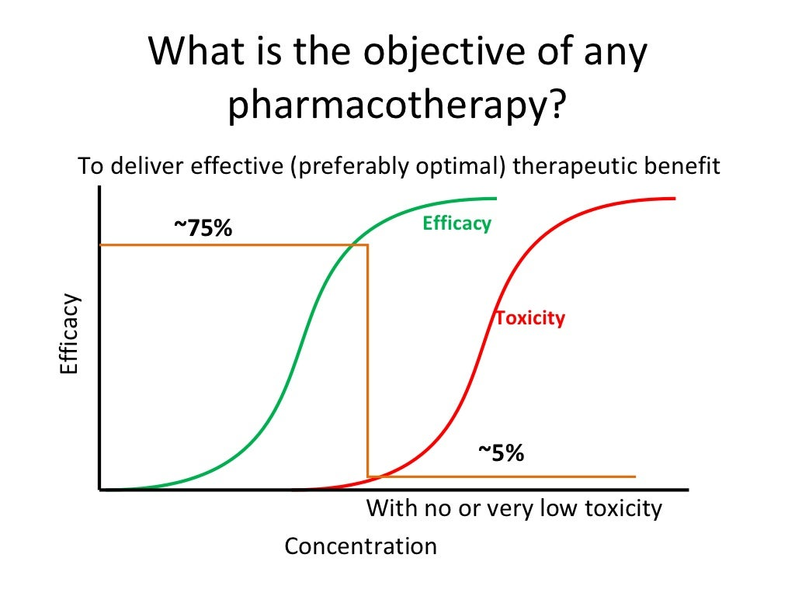
Physiology of Pharmacology
Medications are administered to produce a desired effect in the body.
Pharmacodynamics is the alteration of a function or process of the body as a medication is administered.
  Any medication can cause toxic effects.
Notes:
Lecture Outline
V. The Physiology of Pharmacology
A. Administration to produce a desired effect in the body
1. Pharmacodynamics is the alteration of a function or process of the body as a medication is administered.
2. Any medication capable of beneficial clinical effects can cause toxic effects when:
a. Given at an incorrect dose
b. Given by an incorrect route
c. A delivery device malfunctions
3. Factors related to the patient, patient condition, and particular medication can cause toxicity or adverse effects.

Slide 47
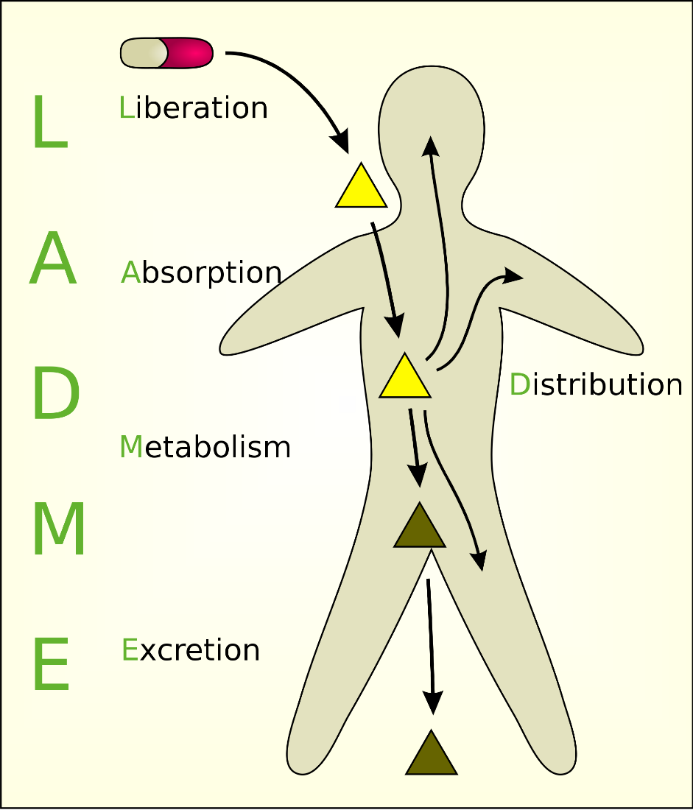
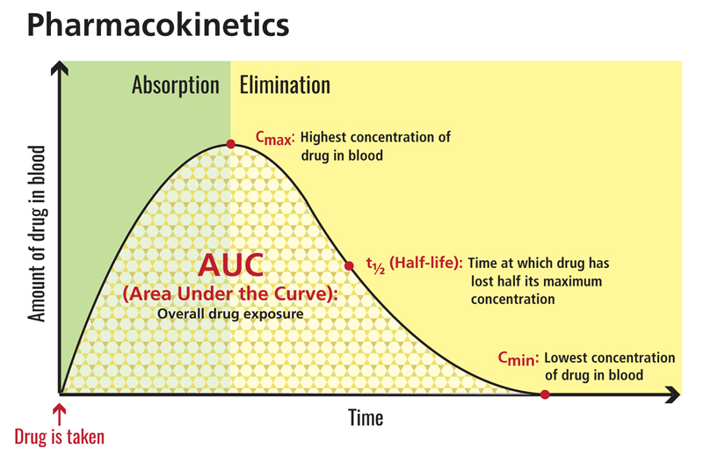
Physiology of Pharmacology
Process of medication administration:
  Absorption
  Distribution
  Biotransformation
  Elimination
Pharmacokinetics: action of the body on a medication
Notes:
Lecture Outline
4. The process of medication or chemical following administration is as follows:
a. Absorption
b. Distribution
c. Biotransformation
d. Elimination
5. Pharmacokinetics is the action of the body on a medication.

Slide 48
Pharmacokintetics

Slide 49

What is a signaling pathway?
Stimulus
Receptor
Action
Feedback

Slide 50
Principles of Pharmacodynamics
Receptor sites exist in proteins connected to cells.
  Receptors are activated by:
    Endogenous chemicals
    Exogenous chemicals (medications and chemicals from outside the body)
Outside my bubble. Please read up!
Notes:
Lecture Outline
B. Principles of pharmacodynamics
1. Research has demonstrated the presence of receptor sites in proteins connected to cells throughout the body.
2. Various receptors are activated by:
a. Endogenous chemicals (chemicals that occur naturally within the body)
b. Medications and chemicals absorbed into the body

Slide 51
Principles of Pharmacodynamics
When a medication binds with a receptor site:
  Channels permitting the passage of ions in cell walls may be opened or closed.
  A biochemical messenger becomes activated.
  A normal cell function is prevented.
  A normal or abnormal cell function begins.
Outside my bubble. Please read up!
Notes:
Lecture Outline
3. When a medication binds with a receptor site, one of four actions will occur:
a. Channels permitting the passage of ions (charged particles) in cell walls may be opened or closed.
b. A biochemical messenger becomes activated, initiating other chemical reactions within the cell.
c. A normal cell function is prevented.
d. A normal or abnormal function of the cell begins.
4. Medications are exogenous chemicals (from outside the body).
a. Exposure to chemicals in the environment can cause effects similar to those of medications, including adverse effects.

Slide 52

Principles of Pharmacodynamics
Medications bind with particular receptor sites of target cells.
  Newer medications target only specific receptor sites.
Notes:
Lecture Outline
C. Development to reach and bind with particular receptor sites of target cells
1. Newer medications target only specific receptor sites in an attempt to minimize adverse effects.
2. Many older medications affect cells and tissues totally unrelated to the condition being treated, causing adverse effects.

Slide 53
Principles of Pharmacodynamics
Two types of medications affect cellular activity by binding with receptor sites:
  Agonist medications initiate or alter a cellular activity.
  Antagonist medications prevent agonist chemicals from reaching cell receptor sites.
Outside my bubble. Please read up!
Notes:
Lecture Outline
3. Two types of medications or chemicals directly affect cellular activity by binding with receptor sites.
a. Agonist medications initiate or alter a cellular activity by attaching to receptor sites, prompting a cell response.
b. Antagonist medications prevent endogenous or exogenous agonist chemicals from reaching cell receptor sites and initiating or altering a particular cellular activity.

Slide 54
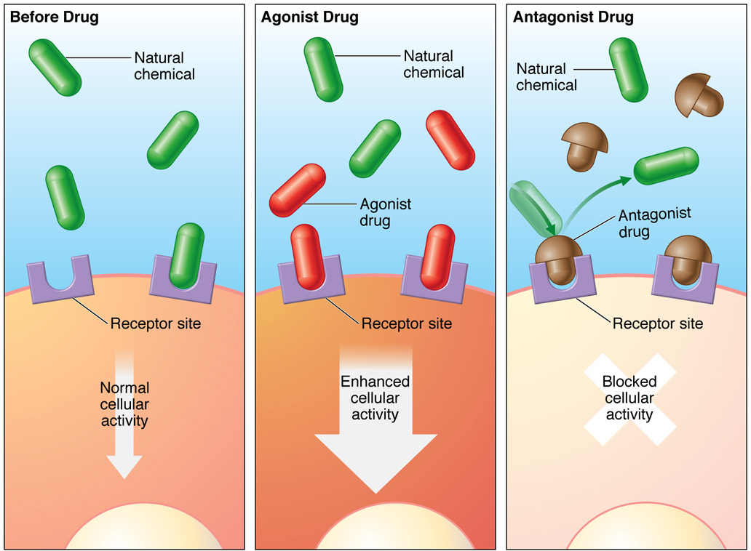
Principles of Pharmacodynamics
© Jones & Bartlett Learning.
Notes:
This figure shows how chemicals bind to receptor sites to cause or block actions.

Slide 55
Agonist Medications
Affinity: ability of a medication to bind with a particular receptor site
Bind with receptor sites.
  Initiate or alter cell action
Outside my bubble. Please read up!
Notes:
Lecture Outline
D. Agonist medications
1. Factors that determine the concentration of a medication present at target cell receptor sites:
a. Dose
b. Route
c. A large number of other factors
2. Affinity: ability of a medication to bind with a particular receptor site
a. Medication concentration and affinity determine the number of receptor sites bound by that medication.
b. Agonist medications bind with receptor sites, initiating or altering cell action.

Slide 56
Agonist Medications
Threshold level: level at which initiation of alteration of cellular activity begins
  Increasing concentrations increase effects.
    All receptor sites become occupied.
    The maximum capacity of the cell is reached.
Notes:
Lecture Outline
3. Threshold level:
a. The level at which initiation of alteration of cellular activity begins
i. Increasing concentrations of medication cause increased effects until:
(a) All receptor sites become occupied
(b) Maximum capacity of cell is reached

Slide 57


Agonist Medications
Potency: concentration of medication required to initiate a cellular response
  As potency increases, the concentration or dose required decreases.
Efficacy: ability to initiate or alter cell activity in a therapeutic or desired manner
Notes:
Lecture Outline
4. Potency
a. Potency is the concentration of medication required to initiate a cellular response.
b. As the potency increases, the concentration or dose required decreases.
c. A higher concentration is required when the potency of a medication is low.
5. Efficacy
a. Ability to initiate or alter cell activity in a therapeutic or desired manner

Slide 58
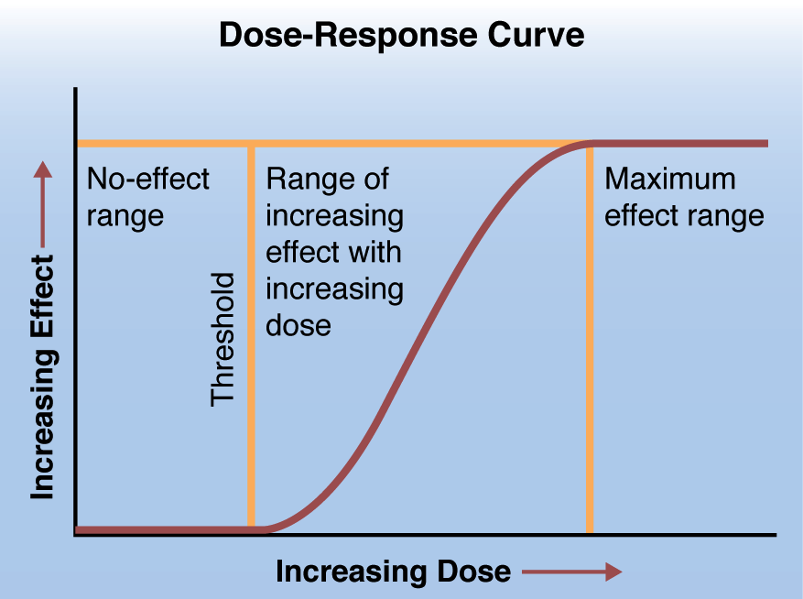
Agonist Medications
© Jones & Bartlett Learning.
© Jones & Bartlett Learning.
Outside my bubble. Please read up!
Notes:
Lecture Outline
6. Limit of change in activity
a. Once all cellular receptor sites become bound with agonist medications, no further change in activity is possible.
b. Further doses will not cause additional cellular action.
7. Dose-response curve
a. Illustrates the relationship of medication concentration and efficacy

Slide 59
Antagonist Medications
Bind with receptor sites to prevent cellular response to agonist chemicals
  Inhibit normal cellular activation
  Treat harmful agonist effects of exogenous medications
Outside my bubble. Please read up!
Notes:
Lecture Outline
E. Antagonist medications
1. Bind with receptor sites to prevent a cellular response to agonist chemicals
2. May be used to:
a. Inhibit normal cellular activation by naturally occurring agonist chemicals within the body
b. Treat the harmful agonist effects of exogenous medications or chemicals
i. Possibly following an overdose or toxic exposure

Slide 60
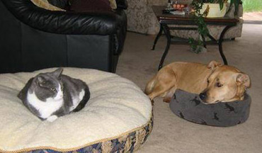
Antagonist Medications
Competitive antagonists
  Temporarily bind with cellular receptor sites.
  Efficacy is related to:
    Concentration near the receptor sites
    Affinity compared with the affinity of the agonist chemicals present
Outside my bubble. Please read up!
Notes:
Lecture Outline
3. May be:
a. Competitive antagonists
i. These agonists temporarily bind with cellular receptor sites, displacing agonist chemicals.
ii. Efficacy is directly related to the antagonist’s concentration near the receptor sites.
(a) As concentration increases, the antagonist prevents a greater number of agonist chemicals from reaching the receptor.
(b) As concentration falls or the concentration of the agonist chemical increases, a greater number of agonist chemicals bind with receptor sites.
(1) Cellular activation resumes
iii. Efficacy is related to the antagonist’s affinity compared with the affinity of the agonist chemicals present.
(a) Medications with a lower affinity require a higher concentration to be effective.

Slide 61
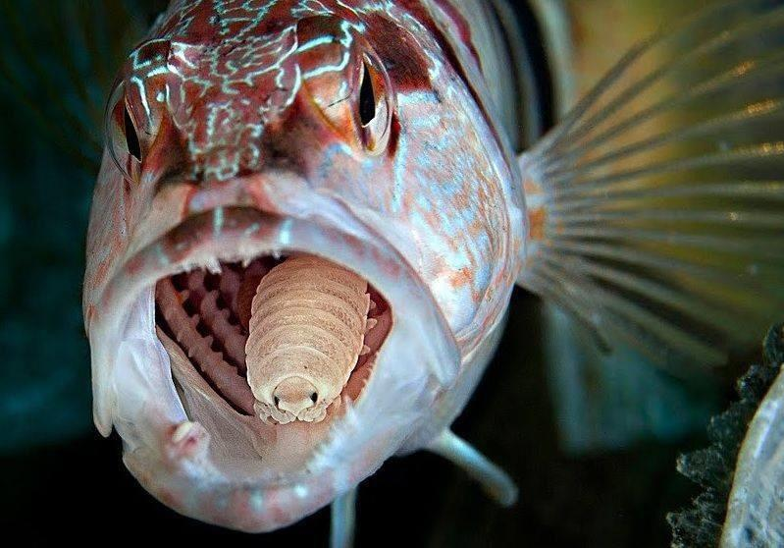
Antagonist Medications
Noncompetitive antagonists
  Permanently bind with receptor sites and prevent activation by agonist chemicals
  Continuation of effects until new receptor sites or cells are created
    Cannot be overcome by increased doses of agonist chemicals
Outside my bubble. Please read up!
Notes:
Lecture Outline
b. Noncompetitive antagonists
i. Permanently bind with receptor sites and prevent activation by agonist chemicals
ii. Have effects that continue until new receptor sites or cells are created
iii. Cannot be overcome by increased doses of agonist chemicals

Slide 62
Partial Agonist Chemicals
Bind to receptor site
  Do not initiate as much cellular activity as other agonists
Lower the efficacy of other agonist chemicals
Outside my bubble. Please read up!
Notes:
Lecture Outline
F. Partial agonist chemicals
1. Bind to the receptor site but do not initiate as much cellular activity or change as do other agonists
2. Effectively lower the efficacy of other agonist chemicals present at the cells

Slide 63
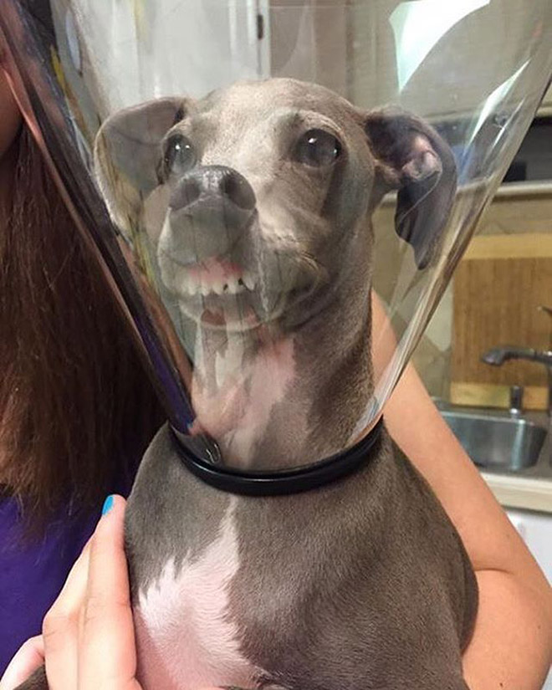
Alternative Mechanisms of Drug Action
Medications can alter cell function without interacting with receptors.
  Engineered to target:
    Microorganisms
    Lipids
    Water
    Exogenous toxic substances
Notes:
Lecture Outline
G. Alternative mechanisms of drug action
1. Alter cell, tissue, organ, and system function without directly interacting with receptors on individual cells
2. Engineered to target other sites throughout the body
a. Microorganisms
b. Lipids
c. Water
d. Exogenous toxic substances

Slide 64
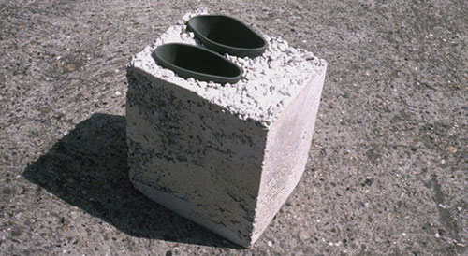
Alternative Mechanisms of Drug Action
Antimicrobials
  May target specific substances present in the cell walls of a bacteria or fungi
  Antibiotics, antifungals
Chelating agents
  Bind with heavy metals
  Create a compound that can be eliminated
Sodium bicarbonate
Outside my bubble. Please read up!
Notes:
Lecture Outline
3. Targeting of specific substances present in the cell walls of a bacteria or fungi
a. Antibiotics
b. Antifungals
4. Chelating agents
a. Bind with heavy metals
i. Lead
ii. Mercury
iii. Arsenic
b. Create a compound that can be eliminated
c. Sodium bicarbonate
i. Breaks down after administration, producing bicarbonate ions
(a) Binds with excess hydrogen ions
(b) Raises the pH
(c) Decreases acidity of various body fluids

Slide 65
Alternative Mechanisms of Drug Action
Diuretics
  Create osmotic changes
  Alter distribution of fluids and electrolytes
Electrolyte-based medications
  Change concentration and distribution of ions in cells and fluids throughout the body
Outside my bubble. Please read up!
Notes:
Lecture Outline
5. Diuretics
a. Create osmotic changes
b. Alter the distribution of fluids and electrolytes
c. Draw excess water away from certain body tissues while enhancing excretion of urine
d. Target water in the body and alter the distribution of various body fluids
6. Electrolyte-based medications
a. Change the concentration and distribution of ions in the cells and fluids throughout the body
b. Affect the ability of various cells to function

Slide 66
Factors Affecting Response to Medications
Choice of medication
Dose
Route
Timing
Manner of administration
Monitoring
Notes:
Lecture Outline
H. Factors affecting response to medications
1. Include:
a. Choice of medication
b. Dose
c. Route
d. Timing
e. Manner of administration
f. Monitoring

Slide 67
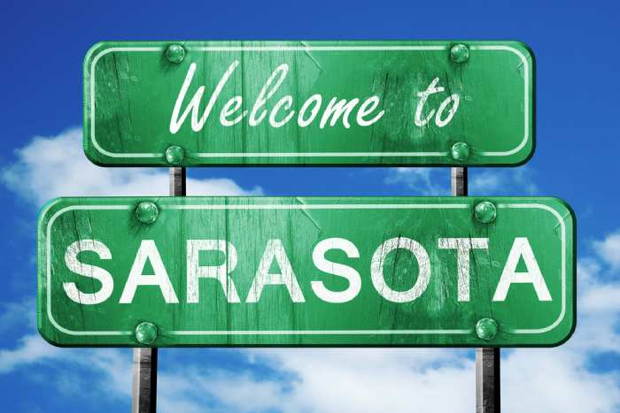
Factors Affecting Response to Medications
Age
  Water-soluble medications
    Higher weight-based doses must be administered to infants than adults and elderly people.
  Fat- and lipid-soluble medications
    Require higher weight-based doses in elderly people
Notes:
Lecture Outline
2. Factors in how a medication affects a patient due to weight-based dosing:
a. Age
i. Medications are distributed into three primary types of body substances:
(a) Water
(b) Lipids or fat
(c) Protein
ii. With water-soluble medications, higher weight-based doses must be administered to infants than to adults and elderly people.
iii. Fat- and lipid-soluble medications require higher weight-based doses in elderly people.

Slide 68
Factors Affecting Response to Medications
Age (cont’d)
  Consider titration of medication for a pediatric or an elderly patient.
    Alteration of metabolism/elimination may prolong effects.
    Patients at extremes of age are disproportionately prone to paradoxical medication reactions.
Notes:
Lecture Outline
iv. When treating pediatric or elderly patients, consider careful titration of medication rather than administering a weight-based dose.
(a) Water-soluble and lipid-soluble medications may require increased initial doses to overcome widespread distribution.
v. Alteration of metabolism and elimination in pediatric and elderly patients may prolong the effects of medications or result in higher concentrations in various tissues.
(a) The cytochrome P-450 system affects medication metabolism in the liver.
(1) Works differently on different types of medications
(2) Extremely variable in infants and children
(3) Has functional decline in elderly people
(b) Decline in liver or kidney function requires a decrease in dosage of many medications.
vi. Patients at extremes of age are disproportionately prone to paradoxical medication reactions.
(a) Patients experience clinical effects opposite from the intended effects of the medication.

Slide 69

Factors Affecting Response to Medications
Weight-based medication dosing
  A quantity of medication is multiplied by the patient’s weight in kilograms.
  Advantages include:
    The amount of medication is proportional to the size of the patient.
    Manufacturers have already calculated factors.
    You can calculate the appropriate dose for all ages.
Notes:
Lecture Outline
b. Weight
i. Weight-based dosing of many medications
(a) A quantity of medication is multiplied by the patient’s weight in kilograms.
ii. Advantages of weight-based dosing:
(a) Amount of medication administered is proportional to the size of the patient
(b) Manufacturers have already calculated factors affecting:
(1) Absorption
(2) Distribution
(3) Metabolism
(4) Rates of elimination
(5) Desired quantity present at target cells or tissues
(c) Can be used to calculate the appropriate medication dose for patients ranging from preterm neonates through large adults

Slide 70
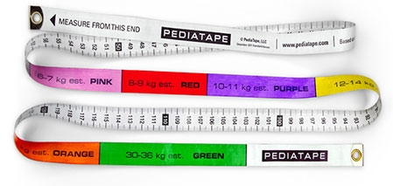

Factors Affecting Response to Medications
Weight-based medication dosing (cont’d)
  Limitations:
    Patient’s weight in kilograms needed
    Does not consider alterations in distribution, metabolism, and elimination
    Some basis on the patient’s ideal body weight
Notes:
Lecture Outline
iii. Limitations of weight-based dosing
(a) Need the patient’s weight in kilograms
(1) In emergency situations, weight must be estimated and converted from pounds to kilograms.
(2) An inaccurate estimation can result in incorrect dosing.
(3) Multiplication errors can result in incorrect dosing.
(b) Does not consider alterations in distribution, metabolism, and elimination
(c) Basis on the patient’s ideal body weight rather than actual body weight

Slide 71
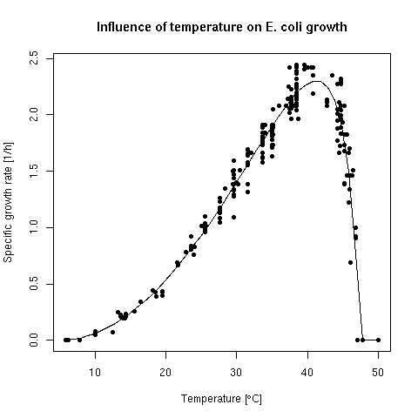
Factors Affecting Response to Medications
Environment
  Hyperthermia
    May increase metabolism of drugs
    May reduce amount of drug returned to circulation
  Hypothermia
    Impairs effectiveness of medications used in traditional cardiac life support
Notes:
Lecture Outline
c. Environment
i. Hyperthermia
(a) May increase metabolism of drugs
(b) May reduce the amount of drug returned to circulation
(c) Suppresses function of cytochrome P-450 system
ii. Hypothermia
(a) Impairs effectiveness of medications used in traditional cardiac life support

Slide 72
Factors Affecting Response to Medications
Genetic factors
  Be careful when administering medications to patients with genetic disorders.
    Primary pulmonary hypertension
    Sickle cell disease
    Glucose-6-phosphate dehydrogenase deficiency
  Patients and family are good sources of information.
Outside my bubble. Please read up!
Notes:
Lecture Outline
d. Genetic factors
i. Be extremely careful when deciding whether to administer medications to patients with specific genetic disorders.
(a) Primary pulmonary hypertension
(1) May have acute decompensation when vasopressor medications are used
(b) Sickle cell disease
(1) Diuretics may cause potentially fatal complications.
(c) Glucose-6-phosphate dehydrogenase deficiency
(1) Salicylate medications may precipitate hemolysis.
ii. Patients and family members are good sources of information.

Slide 73

Factors Affecting Response to Medications
Pregnancy
  Changes can affect absorption, distribution, or elimination of medications.
    Increased cardiac output, intravascular volume, respiratory tidal volume, minute volumes, renal blood flow, and urinary elimination
    Decreased hematocrit, inspiratory/expiratory reserve volumes, and gastrointestinal motility
    Change in endocrine glands
  Need to consider the effect of the medication on the fetus.
Outside my bubble. Please read up!
Notes:
Lecture Outline
e. Pregnancy
i. Many changes take place in the body.
(a) Cardiac output and intravascular volume increase dramatically.
(b) Hematocrit (percentage of red blood cells in the intravascular space) decreases.
(c) Respiratory tidal volume and minute volumes increase.
(d) Inspiratory and expiratory reserve volumes decrease.
(e) Gastrointestinal motility decreases.
(f) Renal blood flow and urinary elimination increase.
(1) Better renal function in a supine position than when upright
(g) The majority of endocrine glands undergo some degree of change.
ii. Each of these changes can affect the absorption, distribution, or elimination of medications.
iii. You also need to consider the effect of the medication on the fetus.
(a) Five FDA pregnancy risk categories: This five-category system is being replaced by a more detailed system that uses narrative summaries to convey prescribing information related to pregnancy, lactation, and risks of a medication to male and female users with reproductive potential.

Slide 74
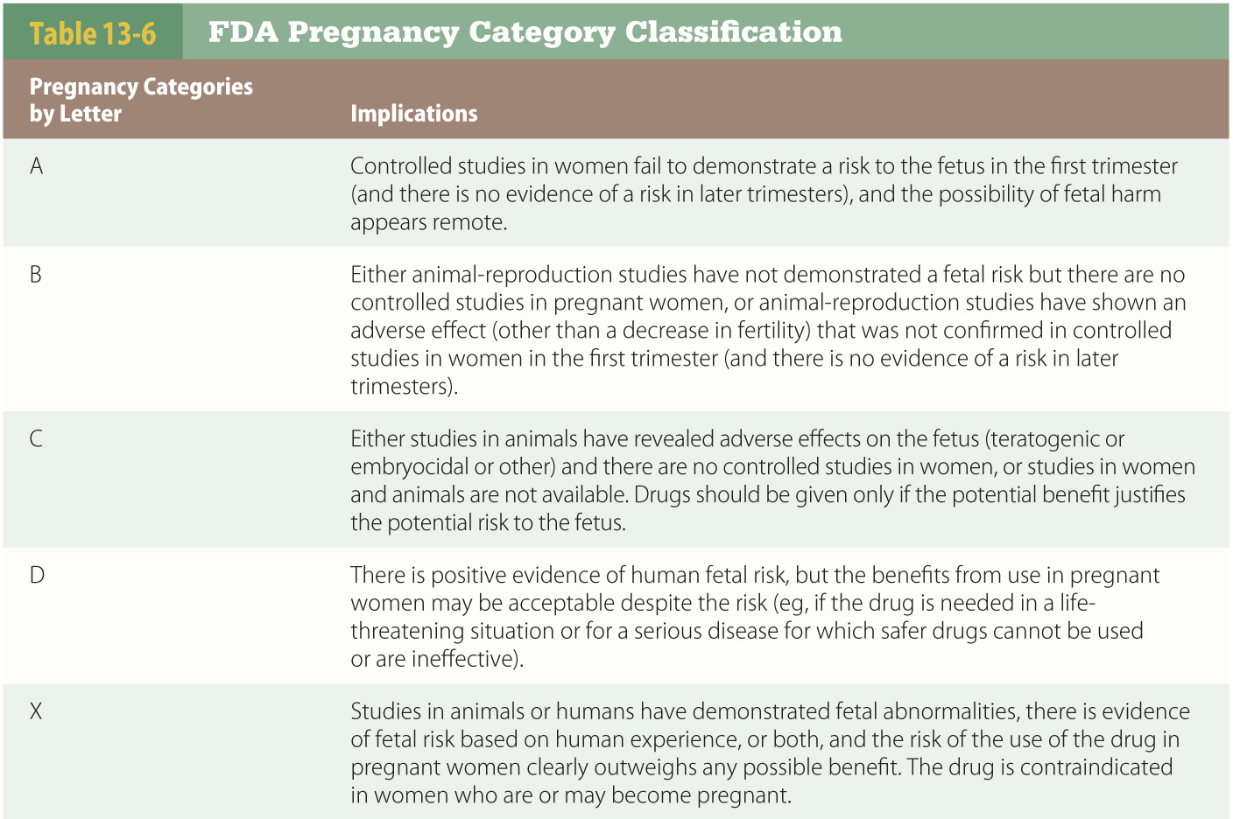
Factors Affecting Response to Medications (1 of 2)
Outside my bubble. Please read up!
Notes:
This table shows the five FDA pregnancy risk categories

Slide 75
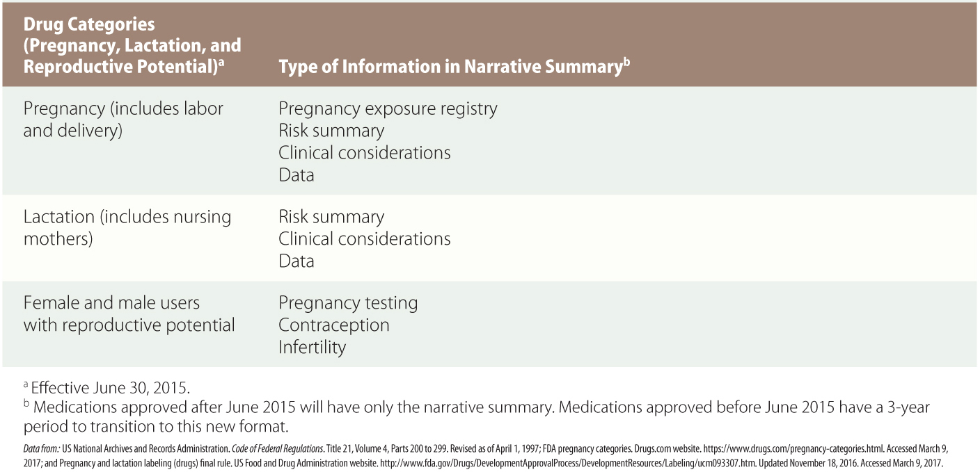
Factors Affecting Response to Medications (2 of 2)
Outside my bubble. Please read up!
Notes:
This table shows the five FDA pregnancy risk categories (cont’d)

Slide 76
Factors Affecting Response to Medications
Psychosocial factors
  Pain, anxiety, and discomfort can vary among individual patients.
  Be alert for verbal and nonverbal cues.
  Medication administration is complicated by the placebo effect.
Outside my bubble. Please read up!
Notes:
Lecture Outline
f. Psychosocial factors
i. Pain, anxiety, and overall discomfort can vary among individual patients with the same illness or injury.
ii. Be alert for verbal and nonverbal cues.
iii. Medication administration is further complicated by the placebo effect.
(a) Patients experience clinical improvement or have adverse effects after receiving medication with no pharmacologic properties.
(b) Pain relief may be from endorphins released by the brain.

Slide 77
Types of Medication Responses
Therapeutic (desired) effects
  Medication is selected based on the patient’s illness, injury, complaint, signs, and symptoms.
  The condition should match the use/indication listed on the medication profile.
Outside my bubble. Please read up!
Notes:
Lecture Outline
I. Types of medication responses
1. Potential for adverse or toxic effects at excessive doses
2. Therapeutic (desired) response
a. Pharmacologic interventions are selected based on a patient’s actual or anticipated:
i. Illness
ii. Injury
iii. Presenting complaint
iv. Signs
v. Symptoms
b. The patient’s condition should match the Use/Indication listed on the profile for the specific medication.
i. Medical directors may authorize off-label uses for approved medications.
ii. When protocols or guidelines do not seem appropriate for the needs of a patient, contact medical control for advice or authorization.

Slide 78
Types of Medication Responses
Therapeutic (desired) effects (cont’d)
  Medication is administered in a dose intended to produce a desired clinical response.
    Some require repeated dosing.
    These are capable of demonstrating cumulative action.
Outside my bubble. Please read up!
Notes:
Lecture Outline
c. Medication is administered in a dose intended to produce a desired clinical response.
i. Some medications require frequent repeated dosing, titrating, or continuous administration.
(a) These medications are capable of demonstrating cumulative action (several smaller doses produce same effect as larger, single dose).
(b) Not every medication or situation allows cumulative action.

Slide 79
Types of Medication Responses
Adverse medication effects
  Clinical changes that are not desired and cause harm or discomfort to the patient
  Consider in relation to the patient’s condition
    Patients with chronic medical conditions are more susceptible.
    Patients may be unable to tolerate even mild adverse effects.
Outside my bubble. Please read up!
Notes:
Lecture Outline
3. Adverse medication effects
a. Side effect and adverse effect are often used interchangeably.
i. Adverse effect clearly indicates possibility of serious consequences.
ii. Some side effects can be beneficial.
iii. Adverse effects may also be referred to as “untoward effects.”
b. Adverse effects are clinical changes, caused by medication, that are not desired and cause some degree of harm or discomfort to the patient.
i. May be directly related to the intended cellular response or to random activation of unrelated cells
c. Some common adverse effects include:
i. Nausea, vomiting
ii. Sedation
iii. Respiratory depression
iv. Dizziness
d. Consider possible adverse effects in relation to the patient’s condition when selecting medications.
i. A medication should be avoided or used with caution in patients who are susceptible to adverse effects associated with that medication.
ii. Patients with certain chronic medical conditions are more susceptible.
(a) Significant cardiovascular disease
(b) Diabetes
(c) Impaired immune function
(d) Renal failure
iii. Some patients may be unable to tolerate even mild adverse effects, including patients with:
(a) Respiratory distress
(b) Shock
(c) Multiple trauma
(d) Other life-threatening conditions

Slide 80
Types of Medication Responses
Adverse medication effects (cont’d)
  May range in severity
  Side effects can be desirable in certain situations and harmful in others
  Can be completely unexpected
    Idiosyncratic medication reactions
Outside my bubble. Please read up!
Notes:
Lecture Outline
e. Adverse effects may range in severity from very minor to life threatening.
i. Cardiomyopathy can be caused by certain antidepressants.
ii. Stevens-Johnson syndrome can be caused by certain antibiotics and antiseizure medications.
iii. A variety of medications can cause anemia through bone marrow suppression or direct hemolysis.
f. An adverse effect can be desirable in certain situations and harmful in others.
g. Some adverse effects can be completely unexpected and not previously known to occur with a particular medication.
i. Known as idiosyncratic medication reactions

Slide 81
Types of Medication Responses
Therapeutic index
  Median lethal dose (LD50): dose that causes death in 50% of animals tested
  Median toxic dose (TD50): dose at or above which causes toxic effects in 50% of animals tested
  Median effective dose
Outside my bubble. Please read up!
Notes:
Lecture Outline
4. Therapeutic index
a. Animal testing establishes:
i. Median lethal dose (LD50): the weight-based dose of a medication that causes death in 50% of the animals tested
ii. Median toxic dose (TD50): the weight-based dose at or above which 50% of the animals tested had toxic effects
iii. Median effective dose

Slide 82
Types of Medication Responses
Therapeutic index is the relationship between the median effective dose and the median lethal dose
  Large difference: The medication is safe.
  Small difference: The patient needs to be monitored.
Outside my bubble. Please read up!
Notes:
Lecture Outline
b. Therapeutic index
i. The therapeutic index is the relationship between the median effective dose and the median lethal dose.
ii. If there is a large difference, the medication is considered safe.
iii. If there is a small difference, the patient needs to be carefully selected and monitored.

Slide 83
Types of Medication Responses
Immune-mediated response
  Genetically predisposed patients have an initial exposure/sensitization to an allergen.
  Medication sensitivity may occur following the first exposure to a medication or substance.
    Avoid administering medications to patients who have had a serious reaction to the medication.
Outside my bubble. Please read up!
Notes:
Lecture Outline
5. Immune-mediated medication response
a. Medications and substances in the environment can cause an exaggerated response from the body’s immune system.
i. Known as an allergic reaction
b. Patients who are genetically predisposed have an initial exposure and sensitization to a particular allergen.
i. Various components of the immune system evolve into antibodies.
ii. When the patient is reexposed to the allergen, a potentially massive cascade of immune system activity occurs.
(a) Known as anaphylaxis
iii. Anaphylaxis can occur days or weeks after initiating a medication.
c. A medication sensitivity may occur following the first exposure to a medication or substance.
i. Treatment is similar to that of an immune-mediated response.
ii. Avoid administering medications to patients who have had a serious reaction to the medication in the past, unless the effect was clearly dose related.

Slide 84
Types of Medication Responses
Medication tolerance
  Certain medications have a decreased efficacy when taken repeatedly.
  Tolerance results from down-regulation.
    Reduces available cell receptors for a particular medication
Outside my bubble. Please read up!
Notes:
Lecture Outline
6. Medication tolerance
a. Certain medications have a decreased efficacy when taken repeatedly.
b. Tolerance results from down-regulation.
i. The mechanism reduces available cell receptors for a particular medication.
ii. The body also compensates for effects of medication by increasing the metabolism and/or elimination of the medication.

Slide 85
Types of Medication Responses
Medication tolerance (cont’d)
  Cross tolerance: Repeated exposure within a particular class has the potential to cause a tolerance to the class.
  Tachyphylaxis: Repeated doses within a short time rapidly causes tolerance.
Outside my bubble. Please read up!
Notes:
Lecture Outline
c. Repeated exposure to a medication within a particular class has the potential to cause a tolerance to other medications in the same class.
i. Known as cross-tolerance
d. Repeated doses of medication within a short time rapidly cause tolerance.
i. Known as tachyphylaxis

Slide 86
Types of Medication Responses
Medication abuse and dependence
  The following are prone to misuse and abuse:
    Stimulants
    Depressants
  Repeated exposure can cause habituation.
  Prolonged or significant exposure can cause dependence.
Outside my bubble. Please read up!
Notes:
Lecture Outline
7. Medication abuse and dependence
a. Two distinct groups of medications and chemicals are prone to misuse and abuse:
i. Stimulants
(a) Cause a transient increase in physical, mental, or emotional performance
(b) Examples: Caffeine, cocaine, amphetamines
ii. Depressants
(a) Reduce CNS and sympathetic nervous system functioning
(b) Examples: Benzodiazepines, alcohol, opioid chemicals
b. Repeated exposure can cause habituation.
i. The abnormal tolerance to adverse or therapeutic effects associated with a substance
c. Prolonged or significant exposure can cause a degree of dependence.
i. Physical, emotional, or behavioral need for substances to maintain a level of normal function

Slide 87
Types of Medication Responses
Medication interactions
  Medication interference is undesirable medication interactions.
  A major concern is incompatibility during administration.
  Medication may increase, decrease, or alter the effect of another medication.
Outside my bubble. Please read up!
Notes:
Lecture Outline
8. Medication interactions
a. Medication interference is undesirable medication interactions.
i. Consider the possibility of illicit drugs, over-the-counter and prescribed medications, and herbal remedies.
b. The major concern is incompatibility during administration.
i. When given simultaneously through the same IV tubing, certain medications will change chemical composition.
ii. Some medications will deactivate others.
iii. Medications require the proper IV solutions.
(a) Some medications can be mixed only in normal saline or dextrose-containing solutions.
c. It is possible for a medication to increase, decrease, or alter the effect of another medication within the body.

Slide 88
Principles of Pharmacokinetics
As a medication is administered, the body begins removing it.
  Duration and effectiveness are determined by:
    Dose
    Route of administration
    Clinical status of the patient
Outside my bubble. Please read up!
Notes:
Lecture Outline
J. Principles of pharmacokinetics
1. As a medication is administered, the body begins moving, and ultimately removing, the medication from the body.
a. Duration and effectiveness of a medication are determined by:
i. Dose
ii. Route of administration
iii. Clinical status of the patient

Slide 89
Principles of Pharmacokinetics
Pharmacokinetics section of a medication profile states:
  Onset: related to absorption and distribution
  Peak: related to absorption and distribution
  Duration: related to metabolism and elimination
Outside my bubble. Please read up!
Notes:
Lecture Outline
2. The pharmacokinetics section of a medication profile states the following:
a. Onset is related to absorption and distribution.
b. Peak is related to absorption and distribution.
c. Duration of effect is related to medication metabolism and elimination.
i. As the amount of the medication near cell receptors decreases, the effects begin to decrease.
ii. If a medication permanently binds with a receptor site or irreversibly alters the function of a cell, the duration is determined by the body’s ability to regenerate cells.

Slide 90
Routes of Medication Administration
The route of administration must allow delivery of the appropriate amount to the correct location.
  Determined by:
    Physical and chemical properties
    Routes of administration available
    How quickly effects are needed
  Bioavailability: percentage of unchanged medication that reaches systemic circulation
    Varies by medication
Outside my bubble. Please read up!
Notes:
Lecture Outline
K. Routes of medication administration
1. Must be capable of delivering an appropriate amount of medication to the correct location in the patient’s body
a. Determined by:
i. Physical and chemical properties of the medication
ii. Routes of administration available for a patient
iii. How quickly effects are needed
b. Bioavailability: Percentage of unchanged medication that reaches systemic circulation
i. Determined by the route of administration
ii. Varies by medication except for the IV route
(a) IV route has 100% bioavailability
iii. Irrelevant for medications sequestered in the gastrointestinal (GI) tract

Slide 91
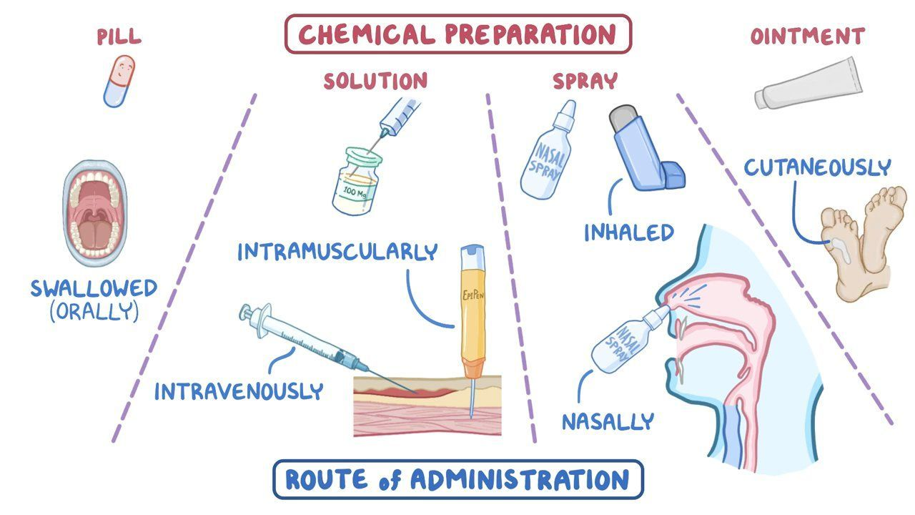
Routes of administration

Slide 92
Routes of Medication Administration
Intravenous
  IV administration is the preferred method in the prehospital setting.
  A catheter is inserted into a peripheral or external jugular vein.
  Bioavailability is 100%.
  Onset is quick.
Notes:
Lecture Outline
5. Intravenous
a. This is the preferred method in the prehospital setting.
b. A small-diameter catheter is inserted into a peripheral or external jugular vein.
i. Medication is administered directly into systemic circulation.
c. Bioavailability is 100%.
d. Onset is quicker than medications given orally or through orogastric or nasogastric tube.

Slide 93
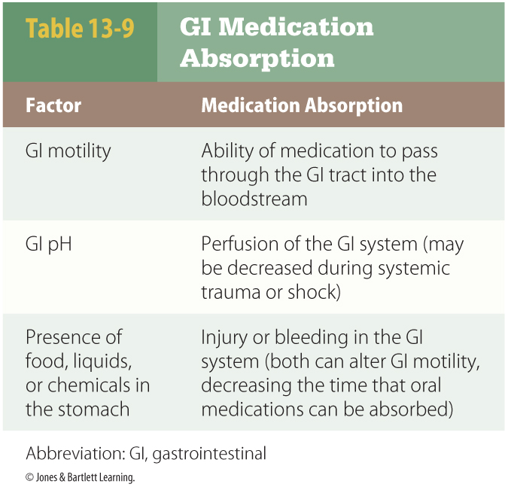
Routes of Medication Administration
Oral, orogastric, and nasogastric tube
  Patient must:
    Be responsive
    Be able to swallow
    Have a nasogastric tube or orogastric tube
Notes:
Lecture Outline
2. Oral, orogastric tube, and nasogastric tube
a. A large number of medications are administered into the GI tracts.
b. The patient must be responsive, be able to swallow, and have a nasogastric tube or orogastric tube.
c. Once administered, medication absorption varies.
d. GI medications may be subject to first-pass metabolism.
e. Metabolism occurs in the liver.
i. Alters and potentially inactivates the medication before it reaches systemic circulation.
f. Metabolism may also occur within the GI tract.
g. Patients with liver dysfunction are at risk of toxicity of these medications when they are given orally.

Slide 94
Routes of Medication Administration
Endotracheal
  Not considered a reliable method
  If endotracheal medications must be given:
    Administer at least 2 to 2.5 times the IV dose.
    Follow with a 5- to 10-mL flush with sterile water or normal saline.
Notes:
Lecture Outline
3. Endotracheal
a. No longer considered a reliable method of medication administration
b. If endotracheal medications must be given:
i. Administer at least 2 to 2.5 times the IV dose.
ii. Follow with a 5- to 10-mL flush with sterile water or normal saline.

Slide 95
Routes of Medication Administration
Intranasal
  Liquid medications are converted into a mist that is sprayed into one or both nostrils.
  Absorption is rapid.
  Bioavailability is close to 100%.
  There is no risk for needlestick injury.
Notes:
Lecture Outline
4. Intranasal
a. Liquid medications are converted into a mist that is sprayed into one or both nostrils.
b. Absorption is rapid.
c. Bioavailability is close to 100% in certain studies.
d. Administration can begin immediately.
e. There is no risk for needlestick injury to the paramedic.

Slide 96
Routes of Medication Administration
Intravenous (cont’d)
  Limitations:
    Access is difficult in several groups of patients.
    The procedure may cause pain or infection and is time consuming.
    Certain classes can cause pain and tissue damage.
Notes:
Lecture Outline
e. Limitations include the following:
i. Access is difficult in several groups of patients.
(a) Patients who have abused IV drugs
(b) Patients in profound shock
(c) Patients with cardiovascular collapse
(d) Patients with certain chronic medical conditions
ii. The procedure may cause pain or infection and is time consuming.
iii. Certain classes such as sympathomimetics can cause pain and tissue damage.

Slide 97
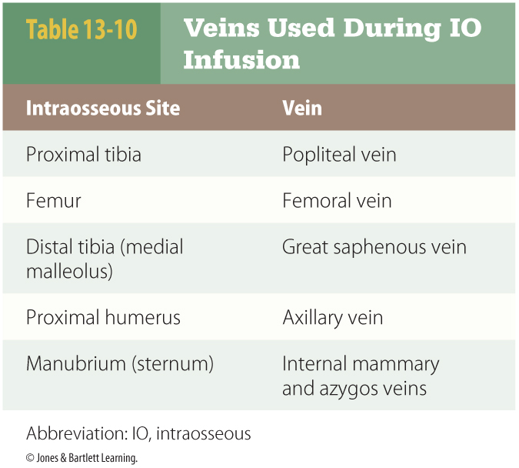
Routes of Medication Administration
Intraosseous
  A needle is inserted into the bone.
  It can generally be left in place up to 24 hours.
  It is contraindicated in bones that are fractured.
Notes:
Lecture Outline
6. Intraosseous (IO)
a. A needle is inserted through the patient’s skin and into the bone.
b. Vascular uptake from the bone marrow provides a reliable rout for medications and IV fluids.
c. Any medication that can administered by IV can be administered intraosseously.
d. The IO needle can generally be left in place up to 24 hours.
e. The IO method is contraindicated in bones that are fractured.
f. This route is discouraged when patients have bone diseases or a skin infection over the insertion site.

Slide 98
Routes of Medication Administration
Intramuscular
  Medication is injected into a large muscle.
  Bioavailability is from 75% to 100%.
  Confirm that:
    The medication is appropriate for IM use.
    A particular muscle should be used.
    A particular technique for injection should be used.
Notes:
Lecture Outline
7. Intramuscular (IM)
a. A sterile medication is drawn into a syringe attached to a needle and injected into one of a patient’s larger muscles.
b. The IM route is used when IV access cannot be established or when the clinical situation requires immediate medication administration.
c. Medications have a bioavailability from 75% to 100%.
d. There is a risk of contaminated needle stick if a patient moves suddenly.
e. Confirm the following:
i. The medication is appropriate for IM use.
ii. A particular muscle should be used.
iii. This particular technique for injection should be used.

Slide 99
Routes of Medication Administration
Subcutaneous
  Medication is injected into subcutaneous tissue site.
  Certain medications are indicated for SC use only.
  Slower absorption may prevent adverse cardiovascular effects.
Notes:
Lecture Outline
8. Subcutaneous (SC)
a. The SC route is similar to IM administration.
b. A sterile medication solution is drawn into a syringe attached to a needle.
c. The medication is injected into various subcutaneous tissue sites throughout the body.
i. Anterior part of abdomen
ii. Just outside the umbilicus
iii. Skin overlaying the triceps
d. Certain medications are indicated for SC use only.
e. Slower absorption may prevent adverse cardiovascular effects.

Slide 100
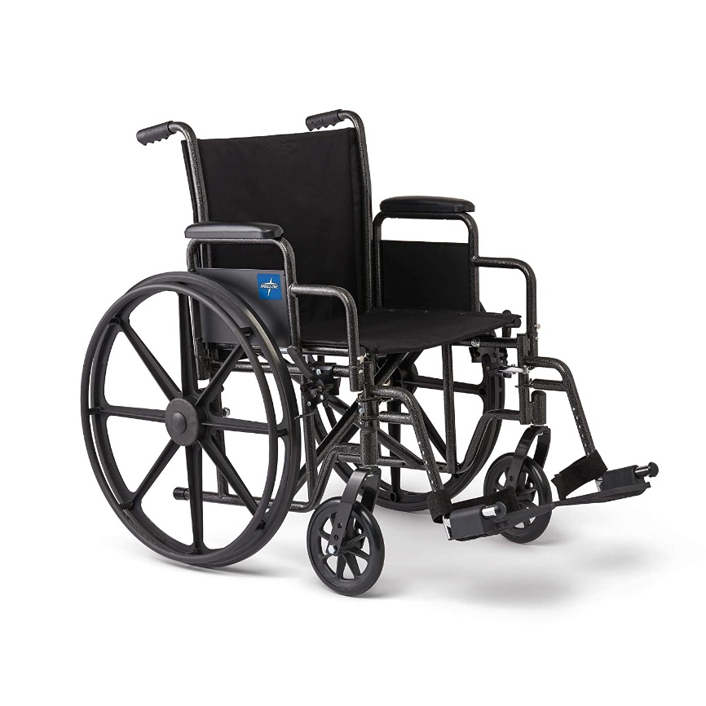
Routes of Medication Administration
Dermal and transdermal
  Medication in patches
  May alter a patient’s clinical presentation or interfere with other medications administered
  Deliver a relatively constant dose of mediation during a long period
  Often contain a large quantity of medication
Notes:
Lecture Outline
9. Dermal and transdermal
a. Patches commonly contain:
i. Nicotine
ii. Antiemetics
iii. Analgesics
iv. Nitroglycerin
b. May alter a patient’s clinical presentation or interfere with other medications administered
c. Deliver a relatively constant dose of mediation during a long period
d. Often contain a large quantity of medication

Slide 101
Routes of Medication Administration
Sublingual
  Medication is placed under patient’s tongue.
  Bioavailability is low.
  Large doses are required.
  Patients must be conscious and alert.
  Nitroglycerin is often given using this route.
Notes:
Lecture Outline
10. Sublingual
a. Nitroglycerin is frequently given using the sublingual route.
i. Medication is placed under the patient’s tongue.
ii. Bioavailability is low.
iii. Large doses are required.
b. Patients must be conscious and alert.
c. A lack of saliva may delay absorption.

Slide 102
Routes of Medication Administration
Inhaled or nebulized
  Limited to oxygen and antidote
  May assist patients with medications via metered-dose inhalers
  Liquid nebulization
    Potential to cause bronchospasm
Notes:
Lecture Outline
11. Inhaled or nebulized
a. Inhaled prehospital medications are limited to oxygen and antidote (amyl nitrate).
b. This method of administration may assist patients with medications via metered-dose inhalers.
i. Convert liquid medicine into gas, allowing it to pass into patient’s lungs.
c. Medication may be nebulized (converted into fine spray).
i. Tubing with oxygen or compressed air is attached to a small chamber, creating a mist as the gas passes through liquid medication.
ii. Portions of the medication are lost during:
(a) Expiration
(b) Pauses in inspiration
d. Nebulized medications have the potential to cause bronchospasm.
i. You should not routinely administer calcium, lidocaine, or other nontraditional medications.

Slide 103

Routes of Medication Administration
Rectal
  Preferred over the oral route if patient is unresponsive, having seizures, vomiting, unable to swallow
  May have greater than 90% bioavailability
  Manufactured in suppository form
  Unpredictable absorption
Notes:
Lecture Outline
12. Rectal
a. Preferred over the oral route if the patient is:
i. Unresponsive
ii. Having seizures
iii. Vomiting
iv. Unable to swallow oral medications
b. The medication is usually not subject to first-pass metabolism.
c. Certain medications administered rectally may have greater than 90% bioavailability.
d. Medications should be administered into the lower rectum (rather than proximal) whenever possible.
e. Rectal preparations are manufactured in suppository form.
i. Waxlike substance molded into shape of a bullet
f. Absorption can be unpredictable.
g. You may administer an IV solution rectally using:
i. A commercial device
ii. A lubricated feeding tube attached to a syringe
iii. A lubricated small diameter syringe
h. Never insert a needle into a patient’s rectum.

Slide 104
Routes of Medication Administration
Ophthalmic
  Generally limited to ocular anesthetic agents
Other methods of administration
  In hemodialysis, blood is pumped through a dialysis machine.
  Paramedics should not use any routes they are not trained to use.
Notes:
Lecture Outline
13. Ophthalmic
a. In the prehospital setting, use is generally limited to ocular anesthetic agents to facilitate irrigation of eyes following a chemical exposure.
b. This route carries the possibility of systematic toxic effects.
14. Other methods of medication administration
a. Hemodialysis
i. Blood is pumped through a dialysis machine, exposing the blood to dialysate solution before returning to the patient.
ii. In hemodialysis, the dialysate solution removes toxins, excess electrolytes, and other chemicals.
b. Training
i. Paramedics should not use any routes of administration they are not trained to use.

Slide 106
Distribution of Medication
How a medication moves through the body is determined by:
  Chemical properties
  Physical properties
  Patient factors
A system of barriers prevents the introduction of foreign substances into the body.
  Medication must move through these barriers.
Outside my bubble. Please read up!
Notes:
Lecture Outline
L. Distribution of medication
1. How a medication moves through the body is determined by:
a. Chemical properties of the medication
b. Physical properties of the medication
c. Patient factors
2. The body has a system of barriers designed to prevent the introduction of foreign substances into the body.
a. Medication molecules must move through these barriers to be effective.

Slide 107
Distribution of Medication
Osmosis is used to enhance the distribution of certain medications.
  Allows IV fluids to leave the intravascular space and enter various tissues and cells
Outside my bubble. Please read up!
Notes:
Lecture Outline
3. Osmosis is used to enhance the distribution of certain medications.
a. Free water and certain particles can pass through a semipermeable membrane to equalize the concentration of the water and other particles on each side of the membrane.
b. This allows IV fluids to leave the intravascular space and enter various tissues and cells.
c. This is one of the mechanisms the kidneys use to regulate fluid balance.

Slide 108
Distribution of Medication
Filtration
  Filtration is the process within the body that is used to redistribute water and other particles.
  Hydrostatic pressure forces various fluids against semipermeable membranes.
Outside my bubble. Please read up!
Notes:
Lecture Outline
4. Filtration is a process within the body that is used to redistribute water and other particles.
a. Hydrostatic pressure forces various fluids against semipermeable membranes, causing the passage of certain substances into an adjacent compartment.

Slide 109
Distribution of Medication
Epithelial cells create a continuous barrier.
  Small nonionic and lipophilic molecules pass easily through cell membranes.
  Larger hydrophilic and ionic molecules must find another route of entry.
    Pinocytosis
    Facilitated diffusion
    Active transport
Outside my bubble. Please read up!
Notes:
Lecture Outline
5. Epithelial cells that create a continuous barrier are contained in the skin, GI tract, eyes, and urinary tract.
a. Medication molecules must pass directly through cells to enter the body.
b. Small nonionic (uncharged) and lipophilic (attracted to fats and lipids) medication molecules pass easily through cell membranes.
c. Larger hydrophilic (attracted to water molecules) and ionic (charged) medication molecules must find another route of entry into cells.
i. Pinocytosis
(a) Process used by larger medication molecules to enter cells
(b) Ingestion of extracellular fluids and their contents
ii. Facilitated diffusion
(a) Process of binding with carrier proteins when no energy is expended
iii. Active transport
(a) Process of binding with carrier proteins when energy is used to move the molecules against a concentration gradient

Slide 110
Distribution of Medication
Medications must also move through capillary walls to reach some tissues.
  Three barriers:
    Blood-brain barrier
    Blood-placenta barrier
    Blood-testes barrier
  Blood passes freely through capillaries in kidney, thyroid, pancreas, lungs, and peritoneum.
Outside my bubble. Please read up!
Notes:
Lecture Outline
6. Medications must also move through capillary walls to reach some tissues.
a. Three barriers prevent molecules from reaching tissues:
i. Blood-brain barrier
ii. Blood-placenta barrier
iii. Blood-testes barrier
b. Molecules pass freely through capillaries in the kidney, thyroid, and pancreas.
c. Molecules pass freely through capillaries in the lungs and peritoneum.

Slide 111
Distribution of Medication
Plasma protein binding
  Medication molecules temporarily attach to proteins in the blood plasma.
  The concentration of medication may change as:
    Plasma protein levels change.
    Another medication that binds with plasma protein is introduced.
Outside my bubble. Please read up!
Notes:
Lecture Outline
7. In plasma protein binding, medication molecules temporarily attach to proteins in the blood plasma.
a. The concentration of the medication in the body may change as:
i. Plasma protein levels change.
ii. Another medication that binds with plasma protein is introduced.
b. Plasma protein binding increases the amount of medication necessary for a desired clinical effect.
c. Plasma protein binding releases medication as circulating levels of a particular medication begin to fall.
i. Leads to longer duration of action.

Slide 112
Distribution of Medication
Lipophilic medications can be sequestered in the fat tissues of an obese person.
  Medication is released slowly, causing prolonged effects.
Outside my bubble. Please read up!
Notes:
Lecture Outline
8. Fat tissue can alter the amount of medication available for action within the body.
a. Lipophilic medications can be sequestered in the fat tissues of an obese person.
i. The medication is released slowly, causing prolonged effects.

Slide 113
Volume of Distribution
Describes the extent to which a medication will spread within the body
  Medications with a lower volume of distribution have higher levels present in the plasma.
Outside my bubble. Please read up!
Notes:
Lecture Outline
M. Volume of distribution
1. Method of distribution describes the extent to which a medication will spread within the body.
a. Some medications do not readily leave the plasma.
b. Some medications spread into water throughout the body.
c. Some medications bind with bone, teeth, or other tissues.
2. Medications with a lower volume of distribution have higher levels present in the plasma at a given dose than do medications with a higher volume of distribution.

Slide 114
Medication Metabolism
Biotransformation: Medication becomes a metabolite.
  Active metabolites: capable of pharmacologic activity
  Inactive metabolites: no longer possess the ability to alter a cell process or body function
Outside my bubble. Please read up!
Notes:
Lecture Outline
N. Medication metabolism
1. Biotransformation is a chemical change that many medications undergo in the body.
a. Medication becomes a metabolite.
i. Active metabolites remain capable of some pharmacologic activity.
ii. Inactive metabolites no longer possess the ability to alter a cell process or body function.

Slide 115
Medication Metabolism
Possible effects of biotransformation:
  An inactive substance can become active.
  An active medication can be changed into another active medication.
  An active medication can be inactivated.
  An active medication can be transformed into a substance that is easier to eliminate.
Outside my bubble. Please read up!
Notes:
Lecture Outline
2. Biotransformation has four possible effects on a medication absorbed into the body.
a. An inactive substance can become active.
b. An active medication can be changed into another active medication.
c. An active medication can be completely or partially inactivated.
d. An active medication can be transformed into a substance that is easier for the body to eliminate.

Slide 116
Medication Metabolism
Most biotransformation occurs in the liver.
  The P-450 system alters the chemical structure of a medication.
  The kidneys, skin, lungs, GI tract, and other tissues may also cause biotransformation.
  Biotransformation makes medications easier to eliminate.
Outside my bubble. Please read up!
Notes:
Lecture Outline
3. Most biotransformation occurs in the liver.
a. P-450 system
i. This system uses a complex, enzyme-based process to alter the chemical structure of a medication or other chemical.
ii. Pathways can be influenced by other medications, chemicals, and diet choices.
4. The kidneys, skin, lungs, GI tract, and many other body tissues have some ability to cause biotransformation as well.
5. Biotransformation makes medications and chemicals more water soluble and easier to eliminate from the body.
6. Suspect altered metabolism in patients with:
a. Chronic alcoholism
b. Liver disease
c. Any condition known to affect the liver

Slide 117
Medication Elimination
Primarily removed by the kidneys
  Influenced by a variety of factors
Two patterns:
  Zero-order elimination: A fixed amount of a substance is removed during a certain period.
  First-order elimination: The rate of elimination is influenced by the substance’s plasma levels.
Outside my bubble. Please read up!
Notes:
Lecture Outline
O. Medication elimination
1. Medication is primarily removed from the body by the kidneys.
2. A variety of factors influence how quickly medication is eliminated.
a. Kidney dysfunction or disease
b. Acute or chronic renal failure
c. Renal blood flow
d. Urinary tract obstruction
e. Alterations in the pH of urine
3. Medications follow two patterns of metabolism and elimination.
a. Zero-order elimination: A fixed amount of a substance is removed during a certain period, regardless of the total amount in the body.
b. First-order elimination (majority of medications): The rate of elimination is directly influenced by the plasma levels of the substance.
i. The more substance in the plasma, the more the body works to eliminate it.

Slide 118
Medication Elimination
Half-life
  Time needed for metabolism or elimination of 50% of the substance in plasma
  Altered by factors such as:
    Disease states
    Changes in perfusion
    Medication interactions
Outside my bubble. Please read up!
Notes:
Lecture Outline
4. Half-life is the time needed in an average person for metabolism or elimination of 50% of the substance in the plasma.
a. Altered by factors such as:
i. Disease states
ii. Changes in perfusion
iii. Medication interactions
b. Refers only to the quantity of medication within the body, not the clinical effects of the medication

Slide 119
Pharmacokintetics

Slide 120
Erica’s summary
I do not know what will be on your test
Most vocab words had “ : ” near them
None of the images are mine,
…except the ones that are.
There is way more material than I could cover in 1 hour.
How you think = most important
Algorithms are key ☺

Slide 121




Thank you!
https://emwrap.org/ems-lecture/

Slide 122
Medication Elimination
Medications are administered at a dose and frequency equal to the body’s rate of elimination.
Smaller amounts of medication can be eliminated in expired air.
Outside my bubble. Please read up!
Notes:
Lecture Outline
5. Medications are administered at a dose and frequency that equals the body’s rate of elimination, resulting in a constant level.
a. Suspect alterations in steady state when patients manifest symptoms of an underlying disease that is usually well controlled by medications.
6. Smaller amounts of medication can be eliminated in expired air from the following:
a. Lungs
b. Stool
c. Saliva
d. Breast milk
e. Perspiration

Slide 123
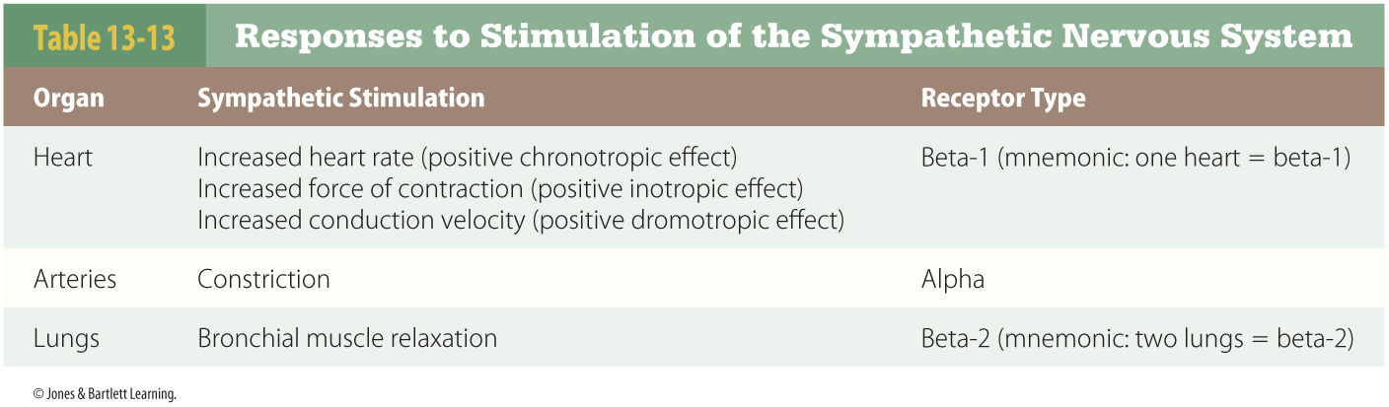
Drugs That Act on the Sympathetic Nervous System
Receptor sites exist in proteins connected to cells throughout the body.
  Activated by chemicals
Notes:
Lecture Outline
VII. Drugs That Act on the Sympathetic Nervous System
A. Receptor sites exist in proteins connected to cells throughout the body.
1. Receptors are activated by chemicals, whether naturally occurring or in the form of a medication.
2. Drugs that influence the sympathetic nervous system are classified according to the receptors with which they interact.

Slide 124
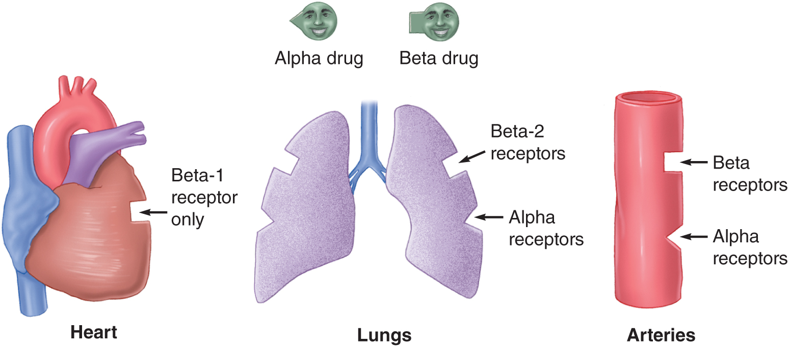
Drugs That Act on the Sympathetic Nervous System
In the sympathetic nervous system, receptors are labeled alpha and beta.
© Jones & Bartlett Learning.
Notes:
Lecture Outline
3. In the sympathetic nervous system, receptors are labeled alpha and beta.
a. Any beta agent will increase the heart’s:
i. Rate
ii. Force
iii. Automaticity
b. Arteries have receptors for alpha and beta agents.
i. An alpha drug will cause vasoconstriction.
ii. A beta agent will cause vasodilation.
c. The lungs have alpha and beta receptors.
i. Alpha agents may cause minor bronchoconstriction.
ii. Beta adrenergic agonists trigger significant bronchodilation.

Slide 125
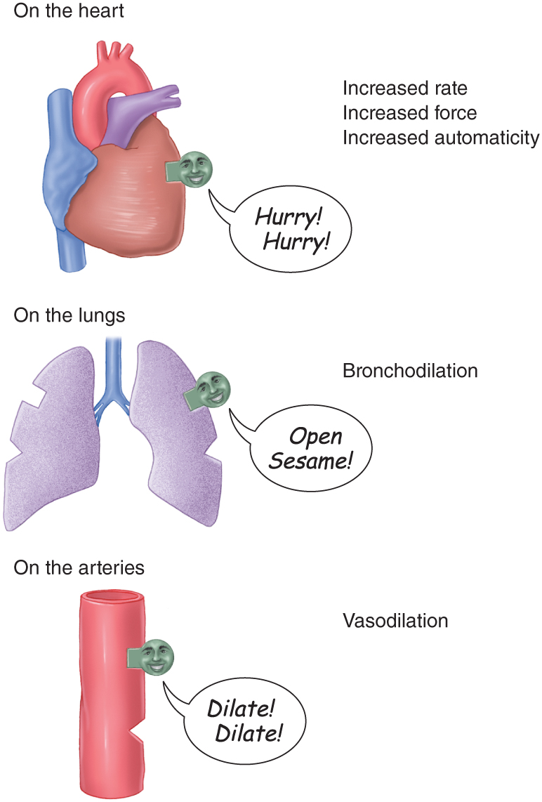
Drugs That Act on the Sympathetic Nervous System
Sympathomimetic drugs
  Drugs that have alpha or beta sympathetic properties
© Jones & Bartlett Learning.
Notes:
Lecture Outline
4. Drugs that have alpha or beta sympathetic properties are called sympathomimetic drugs.
a. If you know whether a sympathomimetic drug is an alpha or beta agent, you can predict the response by the heart, lungs, and arteries.
b. Many sympathomimetic drugs have varying degrees of alpha and beta activity.

Slide 126
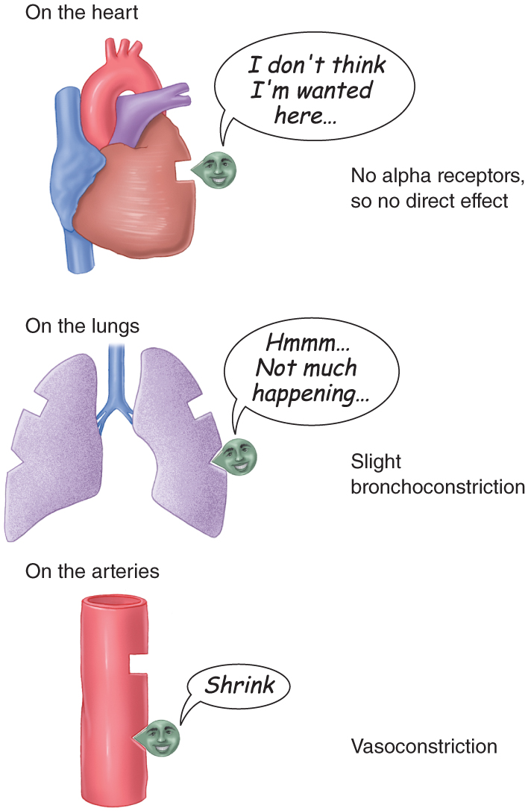
Drugs That Act on the Sympathetic Nervous System
© Jones & Bartlett Learning.
Notes:
These figures show the effects of alpha agents and sympathetic blockers on the heart.

Slide 127
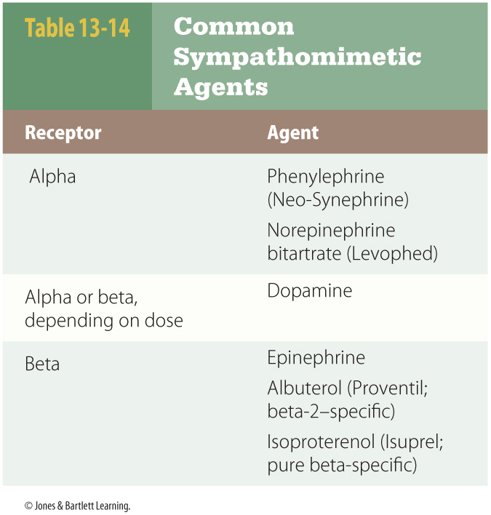
Drugs That Act on the Sympathetic Nervous System
Two groups of beta sympathetic agents
  Beta-1 adrenergic agonists
  Beta-2 adrenergic agonists
Notes:
Lecture Outline
5. Beta sympathetic agents can be classified into two groups based on the subtle differences between the beta receptors in the heart and the lungs.
a. Drugs that act primarily on cardiac beta receptors are called beta-1 adrenergic agonists.
b. Drugs that act chiefly on pulmonary beta receptors are called beta-2 adrenergic agonists.

Slide 128
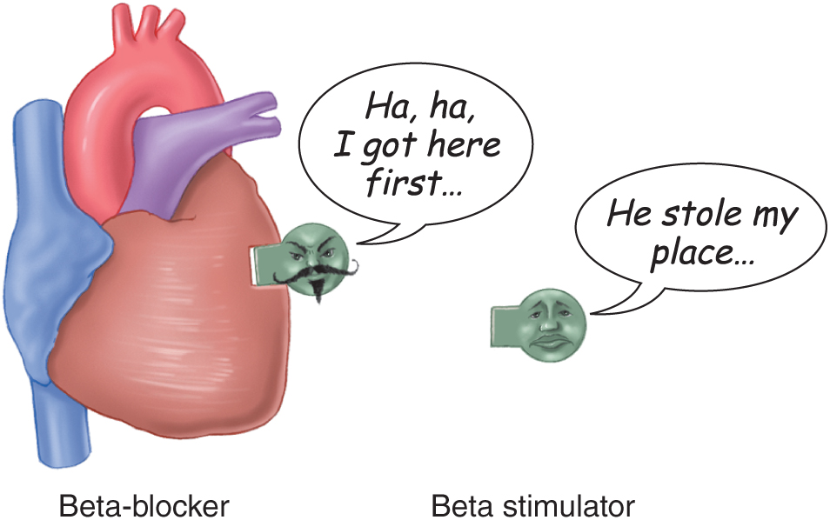
Drugs That Act on the Sympathetic Nervous System
Sympatholytic or sympathetic blockers
© Jones & Bartlett Learning.
Notes:
Lecture Outline
6. Sympatholytic or sympathetic blockers block the action of sympathetic agents by beating them to the receptor sites and preventing these agents from turning on the “ignition.”

Slide 129
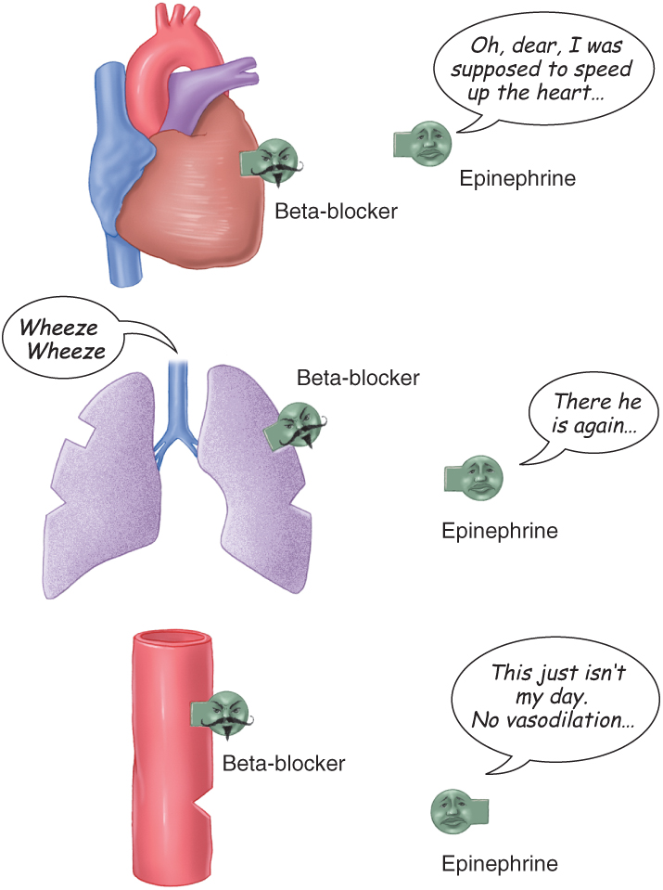
Drugs That Act on the Sympathetic Nervous System
Beta adrenergic blockers
  Prevent beta agents from exerting their full effects
© Jones & Bartlett Learning.
Notes:
Lecture Outline
7. Beta adrenergic blockers occupy beta receptors in the heart, lungs, and arteries, and elsewhere in the body.
a. Beta agents cannot exert their full effects when a beta-blocker has been administered previously.
8. Indications for the major autonomic stimulating and blocking agents can be deduced once you know the properties of the drugs and the manner in which they interact with the autonomic nervous system.
a. Atropine: parasympathetic blocker
b. Norepinephrine: sympathetic agent (primarily alpha)
c. Isoproterenol: sympathetic agent (almost pure beta)
d. Epinephrine: sympathetic agent (predominantly beta)
e. Dopamine: sympathetic agent
f. Albuterol: sympathetic beta-2 agent
g. Propranolol: sympathetic beta-blocker

Slide 130
Medications Used in Airway Management
Sedative-hypnotic agents
  Etomidate (Amidate): imidazole derivative that works as a single-dose profound sedative
    Minimal effect on blood pressure
    Begins working in 30 to 60 seconds
    Lasts approximately 5 minutes
    Maximum one dose
Notes:
Lecture Outline
VIII. Important Medications in the Prehospital Setting
A. Medications used in airway management
1. Rapid-sequence intubation and medication-facilitated airway placement
a. Are controversial procedures in the prehospital setting
b. Are not permitted in all locations
2. Sedative medications
a. Used to secure an artificial airway in patients with an intact gag reflex
3. Sedative-hypnotic agents used in airway management
a. Two ultra–short-acting sedative medications used to facilitate airway placement
i. Etomidate (Amidate)
(a) An imidazole derivative that works as a single-dose profound sedative
(b) Preferred for its minimal effect on blood pressure and other hemodynamic parameters
(c) Begins working in 30 to 60 seconds
(d) Peaks at approximately 60 seconds
(e) Lasts approximately 5 minutes
(f) Causes adrenal suppression if multiple doses are given
(g) No more than one dose should be given.

Slide 131
Medications Used in Airway Management
Sedative-hypnotic agents (cont’d)
  Ketamine (Ketalar)
    Causes profound dissociation and anesthesia
    Can maintain BP and heart rate
    Raises intracranial pressure
    Causes some degree of bronchodilation
Notes:
Lecture Outline
ii. Ketamine (Ketalar)
(a) Causes profound dissociation and general anesthesia
(b) Can maintain BP and heart rate
(c) Raises intracranial pressure
(d) Causes some degree of bronchodilation
(e) May cause an emergent reaction of brief psychosis, disorientation, hallucinations, and other effects

Slide 132
Medications Used in Airway Management
Benzodiazepines
  Potent, antiseizure, anxiolytic, and sedative properties
  High doses for adequate sedation
  Can be used to treat active seizures
  Pregnancy Class D: potentially harmful to the fetus
Notes:
Lecture Outline
4. Benzodiazepines
a. Have potent, antiseizure, anxiolytic, and sedative properties
b. High doses for adequate sedation
i. Causes hypotension
ii. Best used to maintain sedation following airway placement
c. Some degree of seizure protection in patients with head injury
i. Can be used to treat active seizures
d. Lower doses for reduction of anxiety
i. Not approved in all EMS systems
e. Pregnancy Class D: Potentially harmful to the fetus

Slide 133
Medications Used in Airway Management
Flumazenil
  Competitive benzodiazepine antagonist
  Serious potential for life-threatening conditions
  More risky than beneficial in most clinical situations
Notes:
Lecture Outline
f. Flumazenil
i. A competitive benzodiazepine antagonist available in certain health care settings
ii. Serious potential for life-threatening conditions
iii. Several contraindications
iv. Risky
(a) Risks outweigh benefits in most clinical situations
v. Minimal effectiveness of benzodiazepines if seizures occur following administration

Slide 134
Medications Used in Airway Management
Chemical paralytic agents
  Provide muscle relaxation
    Facilitate airway device placement
    Prevents patient-ventilator asynchrony during mechanical ventilation
  Bind with nicotinic receptor sites
    Antagonizes ACh, which normally causes muscle contractions when released
Notes:
Lecture Outline
5. Chemical paralytic agents
a. Provide muscle relaxation that:
i. Facilitates airway device placement
ii. Prevents patient-ventilator asynchrony during mechanical ventilation
b. Bind with nicotinic receptor sites on muscle cells
i. Antagonizes ACh, which normally causes muscle contractions when released

Slide 135
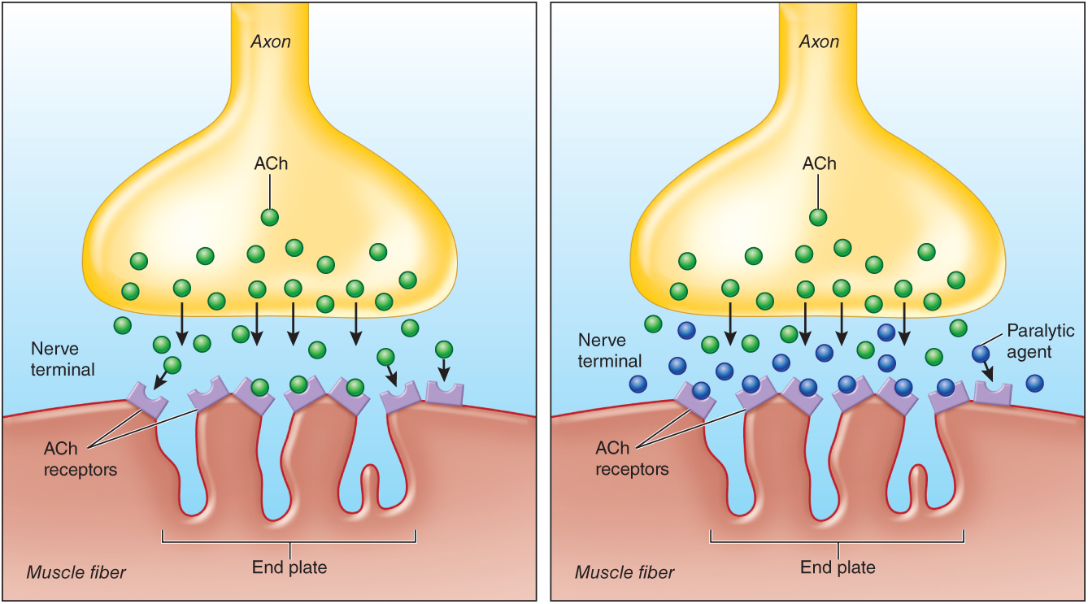
Medications Used in Airway Management
© Jones & Bartlett Learning.
© Jones & Bartlett Learning.
Notes:
This figure shows chemical paralytic medications binding with nicotinic receptors sites on muscle cells.

Slide 136
Medications Used in Airway Management
Chemical paralytic agents (cont’d)
  Succinylcholine (Anectine)
    Competitive depolarizing paralytic agent
    Rapid onset and relatively brief duration
    Adverse effects: hyperkalemia, bradycardia, an elevated intraocular pressure, and malignant hyperthermia
Notes:
Lecture Outline
c. Succinylcholine (Anectine)
i. A competitive depolarizing paralytic agent
(a) Reaches the neuromuscular junctions
(b) Binds with nicotinic receptors on muscles
(c) Causes a brief activation (fasciculation)
(d) Prevents additional activation by ACh
ii. Preferred by many health care providers because of its rapid onset and relatively brief duration
iii. Adverse effects:
(a) May cause or worsen hyperkalemia
(b) May cause bradycardia
(c) May elevate intraocular pressure
(d) May cause malignant hyperthermia

Slide 137
Medications Used in Airway Management
Chemical paralytic agents (cont’d)
  Nondepolarizing paralytic agents
    Compete with ACh at nicotinic receptor sites
    Rocuronium (Zemuron): rapid onset; short duration
    Vecuronium (Norcuron): long onset; available as a powder for reconstitution
Notes:
Lecture Outline
d. Nondepolarizing paralytic agents
i. Compete with ACh at nicotinic receptor sites
(a) Occupy but do not activate receptor sites, preventing activation by ACh
ii. Generally have a longer duration than succinylcholine and fewer adverse effects
iii. Rocuronium (Zemuron): most rapid onset with shorter duration
iv. Vecuronium (Norcuron): longer onset but is available as a powder for reconstitution
e. An immediate threat to life from depolarizing and nondepolarizing chemical agents if an artificial airway is not secured.

Slide 138
Medications Used in Airway Management
Other airway medications
  When upper airway edema is present, the following may be used:
    Corticosteroid
    Vasoconstrictor
    Bronchodilator
Notes:
Lecture Outline
6. Other airway medications
a. When upper airway edema is present, the following may be used:
i. Corticosteroid
ii. Vasoconstrictor
iii. Bronchodilator

Slide 139
Medications Used in Respiratory Management
Beta-agonist medications
  Primary treatment for acute bronchospasm
  Cause muscle relaxation and bronchodilation
  Selective: target only beta-2 receptor sites
  Nonselective: affect beta-1 and beta-2
Notes:
Lecture Outline
B. Medications used in respiratory management
1. Beta-agonist medications
a. The primary treatment for acute bronchospasm associated with asthma, COPD, and a variety of other conditions
i. Smooth muscles in the lower airways contract or relax in response to biochemical changes and external irritants.
ii. Beta-2 receptor sites cause muscle relaxation and bronchodilation when activated by beta-2 agonist chemicals.
b. Selective
i. Target only beta-2 receptor sites
c. Nonselective
i. Affect beta-1 and beta-2

Slide 140
Medications Used in Respiratory Management
Beta-agonist medications (cont’d)
  Albuterol: selective beta-2 agonist
    Typically nebulized or administered using a metered-dose inhaler for emergency treatment of bronchospasm
  Levalbuterol: similar to albuterol
    Fewer beta-1 effects
  Terbutaline and epinephrine
Notes:
Lecture Outline
d. Albuterol: a selective beta-2 agonist medication
i. Typically nebulized or administered using an MDI for emergency treatment of bronchospasm
ii. May cause:
(a) Varying degrees of tachycardia
(b) Metabolic acidosis
iii. Can promote cellular uptake of potassium
(a) Temporarily treats hyperkalemia
e. Levalbuterol
i. Structurally similar to albuterol
ii. Fewer beta-1 effects
f. Terbutaline and epinephrine
i. Used for treatment of bronchospasm
g. Careful monitoring for adverse cardiovascular effects

Slide 141
Medications Used in Respiratory Management
Mucokinetic and bronchodilator medications
  Ipratropium bromide (Atrovent)
    Antagonizes muscarinic receptors
    Causes bronchodilation and decreased mucus in the upper and lower airways
Notes:
Lecture Outline
2. Mucokinetic and bronchodilator medications
a. Ipratropium bromide (Atrovent)
i. Antagonizes muscarinic receptors
(a) Causes bronchodilation and decreased mucus in the upper and lower airways
ii. Administered only every 6-8 hours
iii. Limited cardiovascular effects

Slide 142
Medications Used in Respiratory Management
Corticosteroids
  Administered to reduce airway inflammation and improve oxygenation and ventilation
  Have immunosuppressant properties
  Many contraindications and adverse effects
Notes:
Lecture Outline
3. Corticosteroids
a. Administered to reduce airway inflammation and improve oxygenation and ventilation
b. Reduce severity of respiratory compromise due to:
i. Asthma
ii. COPD
iii. Allergic reactions
c. Examples:
i. Methylprednisolone (Solu-Medrol)
ii. Dexamethasone (Decadron)
iii. Prednisone
d. Have immunosuppressant properties
e. Many contraindications and adverse effects
i. Evaluate the potential risks and benefits for each patient.

Slide 143
Medications Used in Respiratory Management
Leukotriene receptor antagonists
  Taken by patients with asthma and certain allergies on a long-term basis
  Montelukast (Singulair)
  Zafirlukast (Accolate)
Notes:
Lecture Outline
4. Leukotriene receptor antagonists
a. Leukotriene receptor antagonists are reported to be exponentially more potent at causing bronchoconstriction than histamines.
b. Levels of leukotrienes are significantly elevated in patients with asthma.
c. Leukotriene receptor antagonist medications are taken by patients with asthma and certain allergies on a long-term basis.
i. Montelukast (Singulair)
ii. Zafirlukast (Accolate)

Slide 144
Medications Affecting the Cardiovascular System
Antidysrhythmic medications
  Target cells within the heart to:
    Resolve dysrhythmia
    Suppress ectopic foci
  Vaughan-Williams classification groups medications into four classes
Notes:
Lecture Outline
C. Medications affecting the cardiovascular system
1. Three components to cardiovascular system
a. Pump (heart)
b. Plumbing (arteries, veins, and capillaries)
c. Blood
2. Alter the heart or change the tone of blood vessels
3. Antidysrhythmic medications
a. Target cells within the heart to:
i. Resolve dysrhythmia
ii. Suppress ectopic foci (sites of electrical impulse generation)
b. Have the ability to improve or correct abnormalities in a patient’s cardiac rhythm
i. May cause cardiac dysrhythmias and adverse effects
ii. Medical control if necessary
c. Vaughan-Williams classification
i. Groups medications used to treat cardiac dysrhythmias into four classes according to mechanism

Slide 145
Medications Affecting the Cardiovascular System
Five phases of cardiac cell activity
  Phase 4: Cardiac cells are at rest.
  Phase 0: A rapid influx of sodium ions occurs.
  Phase 1: Sodium decreases; potassium exits.
  Phase 2: Calcium moves in; potassium exits.
  Phase 3: Calcium movement ceases; potassium outflow continues.
Notes:
Lecture Outline
d. Five phases of cardiac cell activity
i. Phase 4: Cardiac cells are at rest, waiting for:
(a) Generation of a spontaneous impulse from within (automaticity)
(b) Transfer of an impulse from an adjacent cardiac cell
ii. Phase 0: This phase begins when the cardiac muscle cells receive an impulse with the rapid influx of sodium ions through channels in the cardiac cell.
(a) Potassium ions begin to exit the cell, and depolarization occurs.
iii. Phase 1: Sodium channels close while potassium exits the cell.
iv. Phase 2: Sodium and calcium slowly enter the cell, while potassium continues to leave the cell.
v. Phase 3: Calcium channels slowly close and calcium leaves the cell while potassium channels open, enabling the rapid movement of potassium out of the call.
(a) Repolarization begins during phase 2 and is complete at the end of phase 3.
vi. During phases 0, 1, 2, and up to the middle of phase 3, no additional depolarization may occur because of external stimuli.
(a) Absolute refractory period
(b) Followed by a brief period for a powerful stimulus to initiate depolarization
(1) Known as the relative refractory period

Slide 146
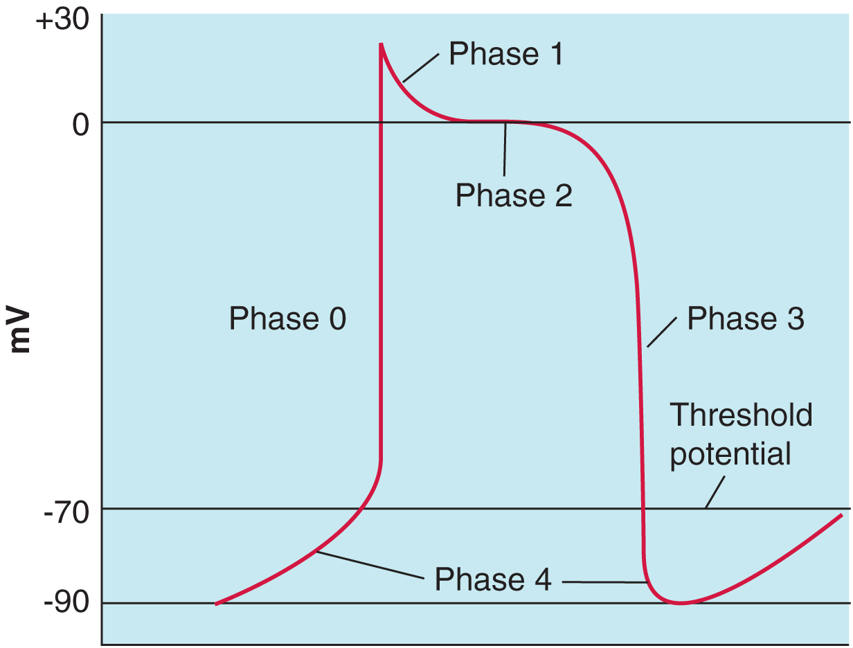
Medications Affecting the Cardiovascular System
Reproduced from 12-Lead ECG: The Art of Interpretation, courtesy of Tomas B. Garcia, MD.
Notes:
This figure shows the action potential in a cardiac muscle cell.

Slide 147
Medications Affecting the Cardiovascular System
Class I: Antidysrhythmic medications
  Slow the movement of sodium in cardiac cells
  Procainamide: suppresses activity of ectopic foci and slows conduction velocity
  Lidocaine: blocks sodium channels
    Resolves ventricular dysrhythmias; suppresses ectopic foci
Notes:
Lecture Outline
e. Class I: Antidysrhythmic medications
i. Slow the movement of sodium through channels in certain cardiac cells
(a) Procainamide suppresses activity of ectopic foci and slows conduction velocity.
(b) Lidocaine blocks sodium channels in Purkinje fibers and ventricles, resolving ventricular dysrhythmias and suppressing ectopic foci.
(1) Poorly absorbed orally and quickly metabolized
(2) Used as a local anesthetic during soft-tissue repair
(3) Used as an adjunct to sedation in patients at risk of increased intracranial pressure
(4) Has significant medication interactions

Slide 148
Medications Affecting the Cardiovascular System
Class II: Antidysrhythmic medications/
beta-adrenergic blocking agents
  Inhibit catecholamine activation of beta receptor sites
  May be capable of beta-1 selectivity at therapeutic doses
  May cause massive conduction abnormalities when given with calcium channel blockers
Notes:
Lecture Outline
f. Class II: Antidysrhythmic medications/beta-adrenergic blocking agents
i. Competitively inhibit catecholamine activation of beta receptor sites
ii. May be capable of beta-1 selectivity at therapeutic doses
iii. Toxic effects:
(a) Bradycardia
(b) Hypotension
(c) Conduction delays
iv. Require extreme caution in patients with reactive airway disease
v. May cause massive conduction abnormalities when given with calcium channel blockers

Slide 149
Medications Affecting the Cardiovascular System
Class II: Antidysrhythmic medications/
beta-adrenergic blocking agents (cont’d)
  Metoprolol (Lopressor): reduces heart rate during myocardial ischemia and atrial tachycardias
Notes:
Lecture Outline
vi. Metoprolol (Lopressor)
(a) Reduces the heart rate during myocardial ischemia and certain atrial tachycardias
(b) Requires monitoring of heart rate and blood pressure and slowly administering medication

Slide 150
Medications Affecting the Cardiovascular System
Class III: Antidysrhythmic medications
  Prolong the absolute refractory period
  Treat atrial or ventricular tachycardias
  Amiodarone (Cordarone)
    Controversial treatment of Wolff-Parkinson-White syndrome
    May cause adverse cardiovascular effects and life-threatening pulmonary conditions
  Sotalol (Betapace)
    Taken orally for ventricular or atrial dysrhythmias
Notes:
Lecture Outline
g. Class III: Antidysrhythmic medications
i. Prolong the absolute refractory period by extending the duration of phases 1, 2, and 3 of the cardiac cycle
ii. Treats atrial or ventricular tachycardias
iii. Amiodarone (Cordarone)
(a) Controversial treatment of Wolff-Parkinson-White syndrome
(b) Administered by IV route
(c) Can be continued orally
(d) May cause severe adverse cardiovascular effects and life-threatening pulmonary conditions
iv. Sotalol (Betapace)
(a) Taken orally for ventricular or atrial dysrhythmias
(b) Can be used IV for termination of ventricular tachycardia

Slide 151
Medications Affecting the Cardiovascular System
Class IV: Antidysrhythmic medications/ calcium channel blockers
  Variety of potential uses
    Reducing blood pressure, controlling heart rate, treatment of cardiomyopathy
  Displace calcium at certain receptor sites or enter smooth muscle cells in place of calcium
  Decrease automaticity of ectopic foci and velocity of cardiac contraction
Notes:
Lecture Outline
h. Class IV: Antidysrhythmic medications/calcium channel blockers
i. Have a variety of potential uses
(a) Reducing blood pressure
(b) Controlling heart rate
(c) May increase myocardial oxygen delivery during periods of ischemia
(d) Inhibit uterine contractions during premature labor
(e) Long-term management of migraines
(f) Treatment of cardiomyopathy
ii. Displace calcium at certain receptor sites or enter smooth muscle cells in place of calcium
iii. Slow conduction through the atrioventricular node
iv. Decrease automacity of ectopic foci
v. Decrease velocity of cardiac contraction

Slide 152
Medications Affecting the Cardiovascular System
Class IV: Antidysrhythmic medications/ calcium channel blockers (cont’d)
  Verapamil (Calan) and diltiazem (Cardizem)
    Control heart rate in patients with atrial fibrillation or atrial flutter
    Administered intravenously over 2 minutes
    Require continuous electrocardiographic monitoring and frequent blood pressure monitoring
Notes:
Lecture Outline
vi. Verapamil (Calan) and diltiazem (Cardizem)
(a) These agents are used to control heart rate in patients with atrial fibrillation or atrial flutter.
(b) Diltiazem has less effect on blood pressure.
(c) Verapamil has a longer room-temperature shelf life and costs less.
(d) Medications are administered IV over 2 minutes.
(e) Verapamil and diltiazem require continuous electrocardiographic monitoring and frequent blood pressure monitoring.

Slide 153
Medications Affecting the Cardiovascular System
Adenosine (unnamed class)
  Decreases cardiac conduction velocity and prolongs the effective refractory period
    Produces pause in cardiac activity
  Used to evaluate the ECG tracing as cardiac electrical activity terminates and resumes
  Rapid onset and brief duration
  Administered through large-bore proximal IV
Notes:
Lecture Outline
i. Adenosine (unnamed class)
i. Can be used to:
(a) Treat paroxysmal supraventricular tachycardia
(b) Assist in diagnosis when the origin or pattern cannot be determined on ECG because of an unusually fast heart rate
ii. Decreases cardiac conduction velocity and prolongs the effective refractory period
(a) Produces a several-second pause in cardiac activity
iii. Used to evaluate the ECG tracing as cardiac electrical activity terminates and resumes
(a) Determines presence of P waves, flutter waves, or evidence of supraventricular activity
iv. Rapid onset and brief duration
v. Half-life of less than 10 seconds
vi. Administered through a large-bore proximal IV site
(a) Followed by 10-mL normal saline flush
(b) Continuous paper ECG recording

Slide 154
Medications Affecting the Cardiovascular System
Alpha-adrenergic receptor antagonists
  Prevent endogenous catecholamines from reaching alpha receptors
    Lower blood pressure
    Decrease systemic vascular resistance
  Prescribed for patients with hypertension, enlarged prostate, or glaucoma
Notes:
Lecture Outline
D. Additional cardiovascular medications
1. Alpha-adrenergic receptor antagonists
a. Prevent endogenous catecholamines from reaching alpha receptors
i. These medications lower blood pressure (particularly diastolic).
ii. They decrease systemic vascular resistance.
iii. Nonselective blockade of alpha-2 receptors causes a reflex tachycardia by allowing an increase of norepinephrine secretion from the sympathetic nervous system.
b. Patients are prone to orthostatic hypotension.
c. Prescribed for patients with:
i. Hypertension
ii. Enlarged prostate
iii. Glaucoma

Slide 155
Medications Affecting the Cardiovascular System
Alpha-adrenergic receptor antagonists (cont’d)
  Clonidine (Catapres): primarily an alpha-2 receptor agonist; emergency treatment of hypertension
  Phentolamine (Regitine): subcutaneously injected to reverse vasoconstriction
  Labetalol (Trandate): alpha-1, beta-1, and
  beta-2 antagonism properties
Notes:
Lecture Outline
d. Clonidine (Catapres)
i. Primarily an alpha-2 receptor agonist
ii. Given orally for emergency treatment of hypertension
iii. Suppresses release of norepinephrine, causing vasodilation
e. Phentolamine (Regitine)
i. Catecholamines and sympathomimetics can cause profound tissue necrosis if extravasation occurs.
(a) Phentolamine can be subcutaneously injected to reverse vasoconstriction in affected tissue.
f. Labetalol (Trandate)
i. Labetalol has alpha-1, beta-1, and beta-2 antagonism properties.
ii. Patients at risk for unopposed alpha stimulation should receive another alpha-adrenergic antagonist before receiving labetalol.

Slide 156
Medications Affecting the Cardiovascular System
Angiotensin-converting enzyme inhibitors
  Alter function of renin-angiotensin system
    Cause blood pressure and cardiac afterload to decrease
    Used to treat hypertension, cardiomyopathy, CHF
  Patients may:
    Have a chronic, dry cough
    Experience sudden, life-threatening angioedema
Notes:
Lecture Outline
2. Angiotensin-converting enzyme inhibitors
a. Known as ACE inhibitors
b. Alter the function of the renin-angiotensin system
i. The system that causes vasoconstriction and fluid retention in response to hypotension or hypoperfusion
c. Cause:
i. Blood pressure to decrease
ii. Cardiac afterload to decrease
d. Useful for treating:
i. Hypertension
ii. Cardiomyopathy
iii. Congestive heart failure
e. Patients taking these medications may:
i. Have a chronic, dry cough
ii. Experience sudden, life-threatening angioedema
f. Close monitoring and supportive treatment
g. Difficult endotracheal intubation

Slide 157
Medications Affecting the Cardiovascular System
Anticholinergic medications
  Atropine: muscarinic receptor antagonist
    Effectiveness is related to its concentration at receptor sites compared with ACh
    Treats bradycardia when vagal stimulation of muscarinic-2 receptors is suspected
Notes:
Lecture Outline
3. Anticholinergic medications
a. Used to treat many cholinergic symptoms associated with excessive release of ACh
b. Atropine
i. A competitive muscarinic receptor antagonist
ii. Effectiveness: related to its concentration at receptor sites compared with ACh
(a) When ACh increases dramatically due to inhibition of acetylcholinesterase, massive doses of atropine may be required.
iii. Used for the treatment of bradycardia when vagal stimulation of muscarinic-2 receptors is suspected
iv. Administered empirically to exclude the possibility of vagal stimulation during episodes of bradycardia with an unidentified cause
v. Unlikely to be effective for the treatment of bradycardia caused by blocked cardiac conduction

Slide 158
Medications Affecting the Cardiovascular System
Anticholinergic medications (cont’d)
  Atropine (cont’d)
    Used before airway manipulation
    Life-saving antidote for acetylcholinesterase inhibitor toxicity
Notes:
Lecture Outline
vi. Used before airway manipulation
(a) Prevents ACh-induced bradycardia
(b) Suppresses the release of saliva and other secretions in the airway
vii. Life-saving antidote for acetylcholinesterase inhibitor toxicity
(a) Administered until respiratory and hemodynamic status improves (regardless of total dose)

Slide 159
Medications Affecting the Cardiovascular System
Catecholamines and sympathomimetics
  Catecholamines: stimulate receptor sites in the sympathetic nervous system
    Contain catechol group and monoamine oxidase group
    Rapidly metabolized, with a brief duration of action
Notes:
Lecture Outline
4. Catecholamines and sympathomimetics
a. Naturally occurring chemicals in the body that stimulate receptor sites in the sympathetic nervous system
i. Contain:
(a) Catechol group
(b) Monoamine oxidase group
ii. Exogenous catecholamines: epinephrine, norepinephrine, and dopamine
(a) These three chemicals cause the fight-or-flight response.
(b) They are manufactured commercially.
iii. Rapidly metabolized, with a brief duration of action

Slide 160
Medications Affecting the Cardiovascular System
Catecholamines and sympathomimetics (cont’d)
  Sympathomimetics: synthetic chemicals that mimic catecholamines
    Include amphetamines, albuterol, phenylephrine, cocaine
    Longer duration than catecholamines
Notes:
Lecture Outline
b. No natural sympathomimetic chemicals within the body
i. Synthetic chemicals that mimic catecholamines:
(a) Various amphetamines
(b) Albuterol
(c) Phenylephrine
(d) Cocaine
ii. Have a longer duration than catecholamines

Slide 161
Medications Affecting the Cardiovascular System
Epinephrine (adrenalin)
  Catecholamine that stimulates alpha, beta-1, and beta-2 receptor sites
  Can be administered intravenously, intraosseously, intramuscularly, subcutaneously, endotracheally, and via nebulizer
  Can dramatically increase cardiac workload and myocardial oxygen demand
Notes:
Lecture Outline
c. Epinephrine (adrenalin)
i. Catecholamine that stimulates alpha, beta-1, and beta-2 receptor sites
ii. Causes:
(a) Potent vasoconstriction
(b) Increase in heart rate, contractility, and cardiac output
(c) Powerful bronchodilation
iii. Can be administered intravenously, intraosseously, intramuscularly, subcutaneously, endotracheally, and via nebulizer
iv. Can dramatically increase the cardiac workload and myocardial oxygen demand

Slide 162
Medications Affecting the Cardiovascular System
Norepinephrine (Levophed)
  Catecholamine that simulates beta-1 and alpha receptor sites
  Administered by continuous IV infusion
  Titrated according to patient response
  Can cause tissue necrosis if extravasation occurs
Notes:
Lecture Outline
d. Norepinephrine (Levophed)
i. Catecholamine that has been commercially manufactured for use
ii. Simulates beta-1 and alpha receptor sites
iii. Causes increase in blood pressure, cardiac contractility, and heart rate
iv. Indications include sepsis, neurogenic shock, and anaphylactic shock
v. Administered by continuous IV infusion
vi. Titrated according to patient response
vii. Can cause tissue necrosis if extravasation occurs
(a) Frequent assessment of IV site is important.
(b) Administer through a central venous catheter when available.

Slide 163
Medications Affecting the Cardiovascular System
Dopamine (Intropin)
  Primary medication for hypotension refractory to volume resuscitation
Dobutamine
  Synthetically manufactured catecholamine that is similar to dopamine
  Not routinely initiated in the prehospital setting
Notes:
Lecture Outline
e. Dopamine (Intropin)
i. Used as primary medication for hypotension refractory to volume resuscitation
ii. Administered using a weight-based infusion calculation
iii. Dramatic variation in clinical effects depending on the dose
(a) A dose of 2.5 to 5 µg/kg/min causes renal and mesenteric artery vasodilation.
(b) A dose of 5 to 10 µg/kg/min causes increased heart rate and contractility.
(c) A dose of 10 to 20 µg/kg/min causes vasoconstriction.
f. Dobutamine
i. A synthetically manufactured catecholamine that is similar to dopamine
Dopaminergic receptors are not activated.
(b) Stimulates beta-1, and to a lesser degree, beta-2 and alpha receptors
ii. May increase heart rate and provide improvement in inotropic effects
iii. Not routinely initiated in the prehospital setting
iv. Administered with an infusion pump with careful cardiac and hemodynamic monitoring
(a) Hypotension is possible.

Slide 164
Medications Affecting the Cardiovascular System
Milrinone (Primacor)
  Functionally similar to dobutamine
  Can be given orally or intravenously
  Can increase cardiac contractility while causing dilation of systemic arteries and veins
  Improves cardiac output
  Increases mortality when used long-term
Notes:
Lecture Outline
g. Milrinone (Primacor)
i. Functionally similar to dobutamine
ii. Can be given orally or intravenously for treatment of heart failure
iii. Has the ability to increase cardiac contractility while simultaneously causing dilation of systemic arteries and veins
iv. Improves cardiac output but increases mortality when used long-term

Slide 165
Medications Affecting the Cardiovascular System
Phenylephrine (Neo-Synephrine)
  Synthetic, almost pure, alpha agonist medication
  Potent vasoconstrictor
  Longer duration than catecholamines
  May cause reflex tachycardia, tachyphylaxis
  Extravasation a major concern
Notes:
Lecture Outline
h. Phenylephrine (Neo-Synephrine)
i. A synthetic, almost pure, alpha agonist medication
(a) Minimal beta effects may be possible at high doses.
ii. Potent vasoconstrictor
iii. Longer duration than catecholamine medications
iv. Used for the treatment of hypotension resulting from a loss of vascular tone
v. May be used as a mucosal vasoconstrictor during artificial airway placement
vi. May cause reflex tachycardia and tachyphylaxis
vii. Extravasation a major concern
(a) Careful monitoring is essential.
(b) Phentolamine should be available.

Slide 166
Medications Affecting the Cardiovascular System
Digitalis preparations
  Increases the strength of cardiac contractions
    Improves cardiac output
    Slows conduction through the AV junction
    Slows heart rate
  May produce a wide variety of adverse reactions
Notes:
Lecture Outline
5. Digitalis preparations
a. Prescribed for treatment of chronic heart failure or certain rapid atrial dysrhythmias
b. Acts by increasing the strength of cardiac contractions
i. Improves cardiac output
ii. Slows conduction through the atrioventricular junction
iii. Allows fewer impulses to be conducted to the ventricles
iv. Slows the overall heart rate
c. May produce a wide variety of adverse reactions
i. Virtually any cardiac dysrhythmia may be caused by the toxic effects of digitalis.
ii. Patients are sensitive to calcium preparations and a decline in serum potassium levels.
d. Commonly used digitalis preparations: digoxin (Lanoxin) and digitoxin (Crystodigin).

Slide 167
Medications Affecting the Cardiovascular System
Direct vasodilator medications
  Used for the management of:
    Uncontrolled hypertension
    CHF
    Myocardial infarction
    Cardiac ischemia
    Cardiogenic shock
Notes:
Lecture Outline
6. Direct vasodilator medications
a. Used for the management of:
i. Uncontrolled hypertension
ii. Congestive heart failure
iii. Myocardial infarction
iv. Cardiac ischemia
v. Cardiogenic shock

Slide 168
Medications Affecting the Cardiovascular System
Direct vasodilator medications (cont’d)
  Nitroglycerin (Nitro-Bid, Nitrostat)
    Dilates veins and coronary arteries
    Physiologic responses: relief of chest pain and decrease in blood pressure
    Beginning adult IV doses: 5 µg/min (can be increased to 200 µg/min)
Notes:
Lecture Outline
b. Nitroglycerin (Nitro-Bid, Nitrostat)
i. Dilates veins and coronary arteries
(a) Decreases cardiac preload
(b) Reduces myocardial oxygen demand
(c) Improves coronary circulation
ii. Effects when administered sublingually by tablet or spray
(a) Begin in 1 to 3 minutes
(b) Peak in 4 to 10 minutes
iii. Effects following IV administration and discontinuation
(a) Begin almost immediately following IV administration
(b) Persist only a few minutes after the IV infusion is discontinued
iv. Physiologic responses
(a) Relief of chest pain
(b) Decrease in blood pressure
v. Beginning adult IV doses: 5 µg/min (can be increased to 200 µg/min)

Slide 169
Medications Affecting the Cardiovascular System
Direct vasodilator medications (cont’d)
  Nitroglycerin (Nitro-Bid, Nitrostat) (cont’d)
    Prone to causing tolerance
    Tablets prone to degradation
    Should not be taken by patients taking phosphodiesterase-5 inhibitors for erectile dysfunction
Notes:
Lecture Outline
vii. Degradation of sublingual tablets
(a) Must be stored in a closed, light-protected container
viii. Binds with the plastic of containers and IV fluids or tubing
(b) Glass bottles for IV administration
ix. Should not be taken by patients taking phosphodiesterase-5 inhibitors used for erectile dysfunction
(a) May cause severe refractory hypotension

Slide 170
Medications Affecting the Cardiovascular System
Direct vasodilator medications (cont’d)
  Sodium nitroprusside (Nipride)
    Potent IV vasodilator affecting the smooth muscle of veins and arteries
    Adjustable IV infusion rates to maintain optimal blood pressure and cardiac output
    Rapidly decreasing effects once infusion stops
Notes:
Lecture Outline
c. Sodium nitroprusside (Nipride)
i. A potent IV vasodilator affecting the smooth muscle of veins and arteries
ii. Often used in conjunction with inotropic medications for the management of cardiogenic shock
iii. Also used for malignant hypertension and in situations where intentional hypotension is desired
iv. Adjustable IV infusion rates to maintain optimal blood pressure and cardiac output
v. Administered by continuous IV infusion
(a) Must have frequent or constant blood pressure monitoring
vi. Rapidly decreasing effects once infusion is discontinued
vii. Metabolized into cyanide and thiocyanate
(a) Can cause toxicity during prolonged infusion

Slide 171
Medications Affecting the Cardiovascular System
Direct vasodilator medications (cont’d)
  Hydralazine (Apresoline)
    Used for hypertensive emergencies, pulmonary hypertension, and pregnant patients with eclampsia or preeclampsia
    Dilates arterioles, lowering pulmonary and systemic vascular resistance
    In emergency, administered over at least 1 minute and repeated up to every 20 to 30 minutes
Notes:
Lecture Outline
d. Hydralazine (Apresoline)
i. May be used for:
(a) Hypertensive emergencies
(b) Pulmonary hypertension
(c) Pregnant patients with eclampsia or preeclampsia
ii. Dilates arterioles, lowering pulmonary and systemic vascular resistance
iii. In emergency, administered over at least 1 minute and repeated up to every 20 to 30 minutes

Slide 172
Medications Affecting the Cardiovascular System
Epoprostenol (Flolan)
  Potent vasodilator
  Inhibits platelet aggregation
  Continuous infusions for some patients
  Not typically administered for the first time in the prehospital setting
Notes:
Lecture Outline
e. Epoprostenol (Flolan)
i. A potent vasodilator
ii. Impacts both pulmonary and systemic blood vessels
iii. Inhibits platelet aggregation
iv. Continuous infusions for some patients
v. Not typically administered to patients for the first time in the prehospital setting
vi. Adverse effects include:
(a) Tachycardia
(b) Palpitations
(c) Dysrhythmia
(d) Bleeding
(e) Flushing
vii. Online medical control consultation if considering adjustments to the continuous infusion rate

Slide 173
Medications Affecting the Cardiovascular System
Diuretic medications
  Administered to:
    Correct volume overload
    Manage CHF
    Improve respiration in pulmonary edema patients
    Potentially preserve kidney function
Notes:
Lecture Outline
7. Diuretic medications
a. Administered to:
i. Correct volume overload
ii. Manage congestive heart failure
iii. Improve respiration in patients with pulmonary edema
iv. Potentially preserve kidney function
b. Eliminate certain toxins and promote excretion of excess electrolytes

Slide 174
Medications Affecting the Cardiovascular System
Diuretic medications (cont’d)
  Furosemide
    Used for diuretic medication, management of hypertension, CHF, liver disease, or kidney dysfunction
    Careful consideration before administering to patients with hemodynamic instability and known electrolyte disturbances
Notes:
Lecture Outline
c. Furosemide
i. Uses:
(a) As diuretic medication
(b) For management of hypertension, congestive heart failure, liver disease, or kidney dysfunction
ii. Careful consideration before administering to patients with hemodynamic instability and known electrolyte disturbances
iii. Administered by IV over 1 to 2 minutes per 40-mg dose

Slide 175
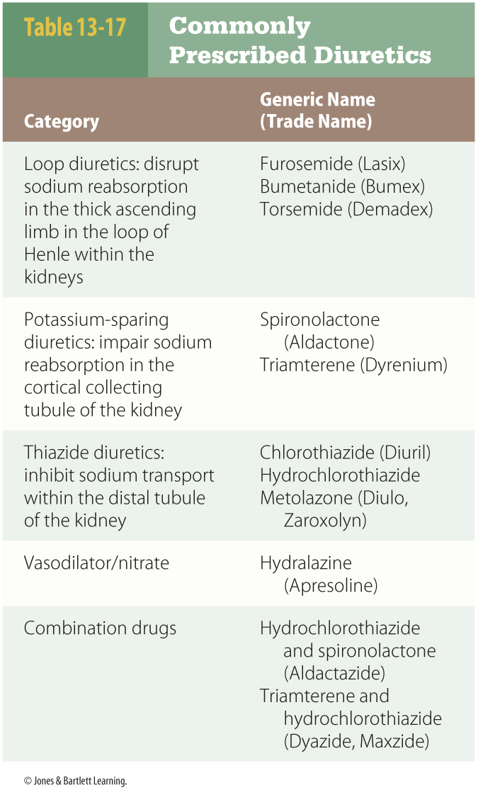
Medications Affecting the Cardiovascular System
Diuretic medications (cont’d)
  Mannitol
    Osmotic diuretic
    Used to decrease intracranial pressure associated with cerebral edema
Notes:
Lecture Outline
d. Mannitol
i. An osmotic diuretic
ii. Used to decrease intracranial pressure associated with cerebral edema
(a) Can target specific body tissues, removing excess water from the brain and eyes
(b) Draws water out of selected body tissues and through the kidneys

Slide 176
Medications Affecting the Cardiovascular System
Antihypertensive agents
  Used to treat hypertension
  Diuretics or beta-blockers may be used
  Patients taking antihypertensives may have symptoms of hypotension
    Orthostatic hypotension
Notes:
Lecture Outline
8. Antihypertensive agents
a. These agents are used to treat hypertension.
b. Many diuretics are also used as antihypertensives or in combination with antihypertensives.
c. Beta-blockers may also be used in the treatment of hypertension.
d. Patients taking antihypertensives may have symptoms of hypotension.
e. Orthostatic hypotension is a feeling of giddiness due to hypotension with a change in position.

Slide 177
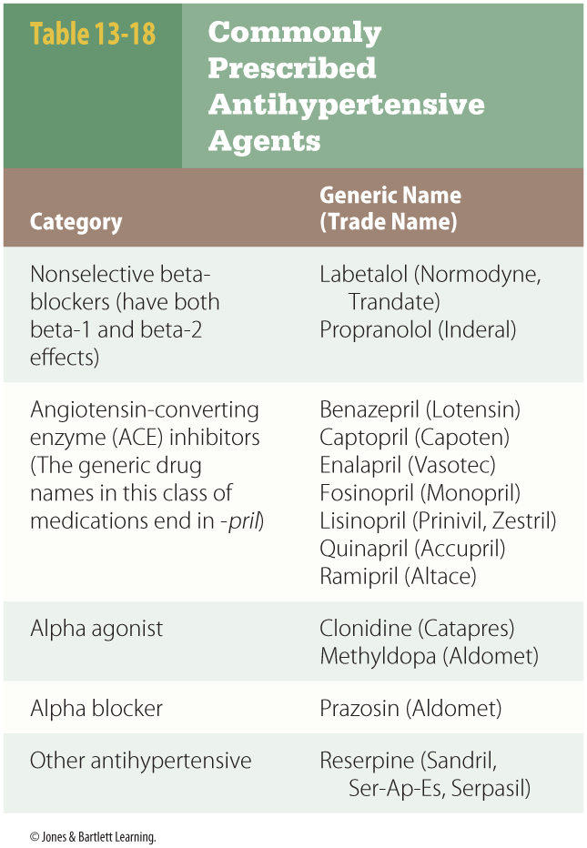
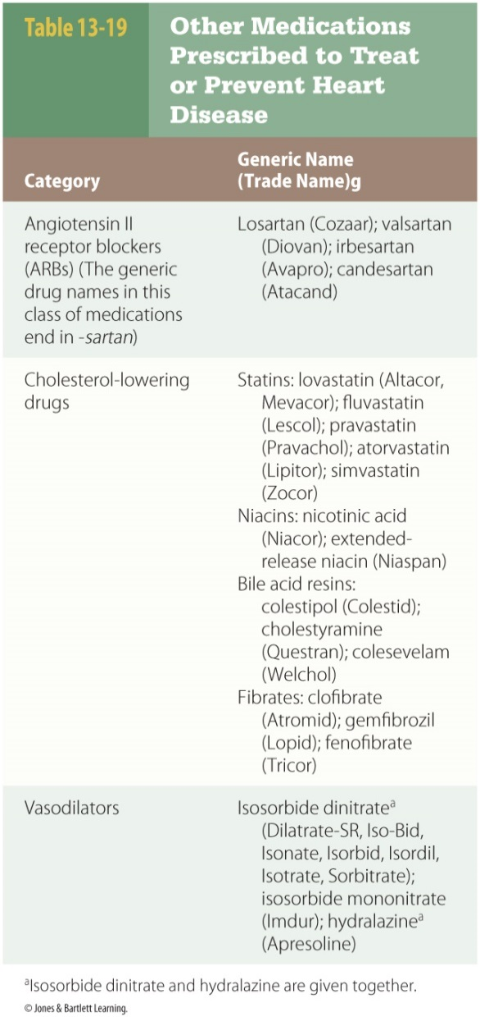
Medications Affecting the Cardiovascular System
Notes:
These tables show commonly prescribed antihypertensive agents, and other medications prescribed to treat or prevent heart disease.

Slide 178
Blood Products and Medication Affecting the Blood
Blood product administration
  The average adult has about 5 L of blood.
  Blood constitutes approximately 7% to 8% of body weight.
  Trauma or a medical condition can alter the total amount, composition, or performance of the blood.
Notes:
Lecture Outline
E. Blood products and medication affecting the blood
1. Manipulation or enhancement of characteristics of the blood for therapeutic purposes
2. Blood product administration
a. The average adult has about 5 L of blood, constituting approximate 7% to 8% of body weight.
i. Blood is roughly 55% plasma.
ii. Water makes up approximately 50% of the total volume.
iii. Red blood cells account for approximately 45% of the volume.
iv. Chemicals, cells, proteins, and hormones make up the remainder.
b. Trauma or a medical condition can alter the total amount, composition, or performance of the blood.

Slide 179
Blood Products and Medication Affecting the Blood
Blood components are:
  Type specific
  Cross-matched
  Unmatched
If choice is not clear, contact online medical control or sending physician.
Notes:
Lecture Outline
c. Blood components are:
i. Type specific to a particular patient
(a) Can be used as soon as the patient’s blood type is known
(b) Greater risk of adverse transfusion reaction
ii. Cross-matched to a particular recipient
(a) Decreased risk of transfusion reaction
(b) Requires a blood sample followed by careful analysis before administration
iii. Unmatched
(a) Most likely to be used in the prehospital setting
(b) Almost always type O, Rh-negative (O negative)
(1) Can theoretically be administered to patients with any blood type
d. During interfacility patient transport, paramedics may need to make a decision concerning which type to use.
i. If choice is not clear, online medical control and sending physician will be valuable resources.

Slide 180
Blood Products and Medication Affecting the Blood
Blood products require careful monitoring during administration.
  Monitor pulse rate and blood pressure.
  Reassess temperature frequently.
  If indwelling urinary catheter is present, monitor for changes in urine color.
Notes:
Lecture Outline
e. Blood products require careful monitoring during administration.
i. Monitor pulse rate and blood pressure.
ii. Reassess temperature frequently.
iii. If indwelling urinary catheter is present, monitor for changes in urine color.
f. Most blood products require special filtered IV tubing.
i. Normal saline is the preferred IV fluid for Y-site tubing administration during blood product transfusions.

Slide 181
Blood Products and Medication Affecting the Blood
Packed red blood cells (PRBCs)
  PRBCs are administered to correct anemia.
  The rate of administration should be proportional to the rate of blood cell loss.
  A unit contains approximately 225 to 250 mL of concentrated RBCs.
  Patients at risk for volume overload require slow administration and careful monitoring.
Notes:
Lecture Outline
3. Packed red blood cells (PRBCs)
a. Correct anemia resulting from:
i. Blood loss
ii. Inadequate RBC production
iii. Massive destruction of circulating RBCs (hemolysis)
b. Rate of administration should be proportional to rate of blood cell loss.
c. A unit of PRBCs contains approximately 225 to 250 mL of concentrated RBCs.
i. Administration of 1 U of PRBCs will increase the hematocrit value by approximately 3%.
d. Patients at risk for volume overload require slow administration and careful monitoring.

Slide 182
Blood Products and Medication Affecting the Blood
Packed red blood cells (cont’d)
  PRBCs are typically administered over no longer than 4 hours per unit.
  Units usually contain a citrate-based preservative.
  Hypocalcemia or hyperkalemia may develop.
Notes:
Lecture Outline
e. PRBCs are typically administered over no longer than 4 hours per unit.
i. PRBCs can be administered rapidly through a commercial pressure infuser-warmer or by using pressure bags for critical patients.
ii. Use the largest IV catheter possible.
(a) Adults: At least 20-gauge (preferably 18-gauge or larger)
iii. Patients with trauma and hemorrhage should have adequate IV fluid resuscitation before or during PRBC administration.
iv. AB is the universal recipient; O is the universal donor.
f. Units of PRBCs usually contain a citrate-based preservative.
i. Hypocalcemia may develop as the citrate binds with calcium.
ii. Patients are also at risk for hyperkalemia.
(a) Suggested by peaked T waves on the ECG tracing

Slide 183
Blood Products and Medication Affecting the Blood
Fresh frozen plasma
  Used to treat impaired blood clotting
  Must be compatible with blood type
    Does not need to be Rh compatible
  Units of 225–250 mL
  Require defrosting before administration
Notes:
Lecture Outline
4. Fresh frozen plasma
a. Use to treat impaired blood clotting
b. Often given following trauma, hemorrhage, warfarin toxicity, disseminated intravascular coagulation, and other conditions
c. Consideration of FFP when large volumes of other blood components are administered
d. Compatibility with a patient’s blood type but not Rh compatible
e. Same volume in units of FFP and units of PRBCs (225–250 mL)
f. Requires adequate defrosting before administration

Slide 184
Blood Products and Medication Affecting the Blood
Cryoprecipitate
  A blood product that contains a concentrated assortment of blood clotting factors
    Without the additional volume present in fresh frozen plasma
Notes:
Lecture Outline
g. Cryoprecipitate
i. A blood product that contains a concentrated assortment of blood clotting factors, without the additional volume present in FFP

Slide 185
Blood Products and Medication Affecting the Blood
Platelets
  Used to correct thrombocytopenia
  Must be blood type and Rh compatible
Notes:
Lecture Outline
5. Platelets
a. Used to correct thrombocytopenia (low platelet level in the blood)
i. Can be caused by trauma, hemorrhage, various chronic medical conditions, and certain anticoagulant medications
b. Must be blood type and Rh compatible

Slide 186
Medications That Alter Blood Performance
Blood platelets combine with coagulation chemicals to terminate bleeding.
When clotting occurs, a thrombus is created.
  Medications can alter the ability of the blood to form a thrombus.
Notes:
Lecture Outline
6. Medications that alter blood performance
a. Blood platelets combine with coagulation chemicals to terminate bleeding.
i. This process is essential for human survival.
(a) Without it, spontaneous bleeding would readily occur and minor trauma would cause death.
b. When clotting occurs in a blood vessel, a thrombus is created.
i. A thrombus can occlude the vessel, jeopardizing dependent cells, tissues, and organs.
ii. Medications that alter the ability of the blood to form a thrombus can be administered.

Slide 187
Medications That Alter Blood Performance
Tranexamic acid
  Promotes blood clotting and reduces mortality in trauma patients with severe bleeding
  Commercial preparation of lysine
  Recommended dose 1 g in an IV infusion over 10 minutes
Notes:
Lecture Outline
7. Tranexamic acid
a. A powerful medication intervention to promote blood clotting and reduce mortality in trauma patients with severe bleeding
b. Blood clot formation in response to an injury and bleeding
i. Often coupled with hyperfibrinolysis, resulting in the rapid dissolving of new blood clots
(a) Will lead to dramatically increased mortality of trauma patients if left unchecked
c. Tranexamic acid
i. A commercial preparation of lysine, an amino acid in the body responsible for preventing breakdown of fibrin clots
ii. Significantly decreases patient mortality if administered within 3 hours of the traumatic event
iii. Current recommended dose: 1 g in an IV infusion administered over 10 minutes.

Slide 188
Medications That Alter Blood Performance
Anticoagulant medications
  Impair function of clotting or coagulation chemicals in the bloodstream
  Enhance the function of substances in the blood that inhibit clot formation
    Prevent formation of clots and growth of existing clots
  Heparin and enoxaparin (Lovenox)
Notes:
Lecture Outline
8. Anticoagulant medications
a. Impair the function of clotting or coagulation chemicals in the bloodstream
b. Enhance the function of substances in the blood that inhibit clot formation
i. Prevent formation of clots and growth of existing clots
ii. Do not dissolve existing clots
c. Heparin and enoxaparin (Lovenox)
i. Enhance antithrombin III to inhibit blood coagulation
ii. Treat or prevent:
(a) Acute coronary syndrome
(b) Deep vein thrombosis
(c) Pulmonary embolus
iii. Enoxaparin as a single IV or SC dose (every 12 hours)
iv. Compatibility of heparin and nitroglycerin and several other infusions
v. Potential to cause bleeding, thrombocytopenia, and other adverse effects

Slide 189
Medications That Alter Blood Performance
Fondaparinux (Arixtra)
  Administered to prevent or treat deep vein thrombosis
Warfarin (Coumadin)
  Common anticoagulant
  Patients are at risk of life-threatening bleeding if warfarin levels are not adequately controlled, following trauma, or when other hemorrhage occurs
Notes:
Lecture Outline
d. Fondaparinux (Arixtra)
i. Typically administered to prevent deep vein thrombosis, to treat thrombosis, or during the period immediately following an ST-elevation myocardial infarction to prevent reinfarction.
e. Warfarin (Coumadin)
i. Warfarin is a common anticoagulant for treatment or prevention of blood clots.
ii. Works by preventing the production of four different blood clotting factors that use vitamin K.
iii. Patients are at risk of life-threatening bleeding when warfarin levels are not adequately controlled, following trauma, or when any other hemorrhage occurs.
iv. Certain foods, alcohol, and a variety of medications can increase effects from warfarin.
v. Warfarin levels are inferred by blood prothrombin time (PT) and international normalized ratio (INR) levels.
vi. Several treatment options are available if patients taking warfarin develop severe bleeding or require emergency surgery.
vii. Warfarin can be reversed through administration of vitamin K given as intermittent IV infusions.
(a) Paramedics are not likely to be involved in the decision to reverse warfarin-related coagulopathy.

Slide 190
Medications That Alter Blood Performance
Antiplatelet medications
  Prevent new thrombus formation or extension of an existing thrombus
  Include:
    Aspirin
    Clopidogrel (Plavix) and ticlopidine (Ticlid)
    Glycoprotein IIb/IIa inhibitor medications
Notes:
Lecture Outline
9. Antiplatelet medications
a. Used to reduce platelet aggregation to prevent new thrombus formation or extension of an existing thrombus
b. Aspirin
i. Oral medication
ii. Treats acute coronary syndrome
iii. Indicated for treatment of stroke once presence of hemorrhage has been excluded
iv. Possibility of aneurysm
(a) Aspirin has the potential to complicate any condition associated with bleeding.
v. Rapidly eliminated, but effects last until all platelets are replaced (may take up to 10 days)
c. Clopidogrel (Plavix) and ticlopidine (Ticlid)
i. Oral medications
ii. Inhibit platelet aggregation
iii. Clopidogrel: superior to aspirin
iv. Ticlopidine: several adverse effects
d. Glycoprotein IIb/IIIa inhibitor medications
i. Include:
(a) Abciximab
(b) Tirofiban
(c) Eptifibatide
ii. Provide potent platelet inhibition
iii. Administered by IV infusion
iv. Adverse effects: bleeding and thrombocytopenia

Slide 191
Medications That Alter Blood Performance
Fibrinolytics
  Dissolve blood clots in arteries and veins
  Can cause life-threatening hemorrhage
  Avoidance of multiple IV attempts and unnecessary trauma
  Prolonged prehospital time may preclude administration.
Notes:
Lecture Outline
10. Fibrinolytics
a. Dissolve blood clots in arteries and veins
b. Administered for emergency treatment of acute myocardial infarction and stroke
c. Administered in lower doses to open certain vascular catheters that have become occluded by a presumed blood clot
d. Can cause life-threatening hemorrhage
i. Many absolute and relative contraindications
e. Avoidance of multiple IV attempts and unnecessary trauma in any patient who is a likely candidate for fibrinolytics
f. Prolonged prehospital time may preclude administration of fibrinolytics.

Slide 192
Medications Used for Neurologic Conditions
Opioid (narcotic) medications
  Used as analgesics in prehospital setting
  Stimulate opioid receptors to relieve pain
  Known to cause tolerance, cross-tolerance, and addiction
  Can cause profound sedation, respiratory depression, and apnea when excessive doses are administered
Notes:
Lecture Outline
F. Medications used for neurologic conditions
1. Opioid (narcotic) medications that act as analgesics in the prehospital setting
a. They are effective at eliminating or reducing pain.
b. Naloxone is a powerful reversal agent.
c. Benzodiazepine medications treat persistent seizure activity.
i. Also work for sedation and treatment of anxiety
2. Opioid analgesic medications
a. Stimulate opioid receptors in the body to relieve or prevent pain
i. Also suppress cough reflex
b. Known to cause tolerance, cross-tolerance, and addiction
i. Patients who receive opioid substances on a long-term basis often require high doses for relief of pain.
(a) May experience withdrawal symptoms if opioid reversal is required
c. Can cause profound sedation, respiratory depression, and apnea when excessive doses are administered
i. Other adverse effects include:
(a) Hypotension
(b) Bradycardia
(c) Palpitations
(d) Dysrhythmias
(e) Noncardiogenic pulmonary edema

Slide 193
Medications Used for Neurologic Conditions
Opioid medications (cont’d)
  Morphine sulfate
    Known to cause nausea or vomiting in up to 60% of patients
    May produce a histamine release
  Fentanyl (Sublimaze)
    Does not have the same risk of nausea and histamine release
    Can be administered intranasally
Notes:
Lecture Outline
d. Morphine sulfate
i. Used frequently in EMS
ii. Known to cause nausea or vomiting in up to 60% of patients
(a) Use caution when administering to patients who are unable to protect their airway.
iii. May produce a histamine release that causes itching, flushing, and diaphoresis
e. Fentanyl (Sublimaze)
i. Generally not as prone to causing hypotension
ii. Does not have the same risk of nausea and histamine release as morphine
iii. Can be administered intranasally

Slide 194
Medications Used for Neurologic Conditions
Opiate antagonist medication
  Naloxone
    Reverses the effects of excessive opioid chemicals in the body
    Efficacy is dose dependent
    Only administer enough to correct life-threatening conditions
Notes:
Lecture Outline
3. Opiate antagonist medication
a. Naloxone
i. This is used to reverse the effects of excessive opioid chemicals in the body.
(a) Competes with opioid chemicals at opioid receptor sites
ii. Efficacy is dose dependent.
(a) Large doses are often required to reverse the effects of potent opioid chemicals.
(b) Duration is less than that of many opioid chemicals.
(1) Severe opioid overdose requires repeated naloxone administration or continuous IV infusion.
iii. Only administer enough to correct life-threatening conditions.

Slide 195
Medications Used for Neurologic Conditions
Opiate antagonist medication (cont’d)
  Phenytoin (Dilantin) and fosphenytoin (Cerebyx)
    Prevent seizure activity
    May be received on a long-term basis
    Administered by IV infusion
    Fewer adverse effects from fosphenytoin than phenytoin
Notes:
Lecture Outline
4. Phenytoin (Dilantin) and fosphenytoin (Cerebyx)
a. Administered to prevent seizure activity
i. May be received on a long-term basis
b. Administered by IV infusion, usually for 10 to 30 minutes
c. Decrease the potential for seizure activity by:
i. Altering sodium channels
ii. Limiting cellular sodium in portions of the central nervous system
d. Fewer adverse effects from fosphenytoin than phenytoin
i. Both medications can cause a variety of adverse effects.

Slide 196
Medications Affecting the Gastrointestinal System
Histamine-2 receptor antagonists
  Decrease acid secretion in the stomach
  Prevent histamine from stimulating receptor sites on parietal cells in the stomach
  Include ranitidine (Zantac), cimetidine (Tagamet), and famotidine (Pepcid)
Notes:
Lecture Outline
G. Medications affecting the gastrointestinal system
1. Histamine-2 receptor antagonists
a. Decrease acid secretion in the stomach
i. Prevent histamine from stimulating receptor sites on parietal cells in the stomach
ii. Acid reduction, protection against ulcers, GI bleeding, acid-aspiration pneumonitis, and a variety of other related conditions
b. Include:
i. Ranitidine (Zantac)
ii. Cimetidine (Tagamet)
iii. Famotidine (Pepcid)

Slide 197
Medications Affecting the Gastrointestinal System
Antiemetic medications
  Used to treat nausea and vomiting
  Promethazine (Phenergan) and prochlorperazine (Compazine)
    These agents can be given orally or via IV.
    Adverse effects are related to IV administration.
Notes:
Lecture Outline
2. Antiemetic medications
a. Used to treat nausea and vomiting
i. Vomiting can dramatically worsen many serious medical conditions.
(a) May cause Mallory-Weiss tear, leading to GI bleeding
(b) May raise intracranial and intraocular pressure
(c) May cause pulmonary aspiration
(d) May be lethal if combined with aspiration of activated charcoal
b. Promethazine (Phenergan) and prochlorperazine (Compazine)
i. These medications have antiemetic and antipsychotic properties.
ii. Both medications can be given orally or via IV.
iii. A number of adverse effects are related to IV administration.
(a) May be diluted in a large syringe and administered over 1 to 2 minutes
(b) Ideally, should be diluted in 50 mL of normal saline and administered for 10 minutes
iv. Promethazine is known to cause tissue injury during IV administration.
v. Prochlorperazine is known to cause hypotension if administered rapidly.
vi. Dystonic reactions are possible, causing unusual muscle activity and significant patient discomfort.
vii. Many other potential adverse effects are possible.

Slide 198
Medications Affecting the Gastrointestinal System
Antiemetic medications (cont’d)
  Metoclopramide (Reglan)
    Increases GI motility
    Available orally, by slow IV injection, and by IV infusion
  5-HT3 receptor antagonists
    Prevent certain mechanisms that induce vomiting
    Available in oral and IV preparations
Notes:
Lecture Outline
c. Metoclopramide (Reglan)
i. Increases GI motility by enhancing the effects of ACh at receptor sites in the upper GI tract
(a) Promotes gastric emptying
ii. Can administered orally, by slow IV injection, and by IV infusion
(a) Dystonic reactions are possible.
d. 5-HT3 receptor antagonists
i. The 5-HT3 receptors play a prominent role in activation of vomiting center of the brain.
ii. These medications prevent certain mechanisms that induce vomiting.
iii. They include:
(a) Ondansetron
(b) Granisetron (Kytril)
(c) Dolasetron (Anzemet)
iv. They are available in oral and IV preparations.
v. Adverse effects are minimal.

Slide 199
Medications Affecting the Gastrointestinal System
Octreotide (Sandostatin)
  Synthetic version of somatostatin
  Decreases secretion of insulin, glucagons, growth hormones, and various other chemicals
  Has many potential uses
  Not routinely administered in prehospital setting
Notes:
Lecture Outline
3. Octreotide (Sandostatin)
a. Not routinely administered in the prehospital setting
b. A synthetic version of somatostatin
i. Decreases secretion of insulin, glucagon, growth hormones, and various other chemicals
c. Has many potential uses
d. Wide variety of adverse effects

Slide 200
Miscellaneous Medications Used in the Prehospital Setting
Acetaminophen (Tylenol, APAP)
  Antipyretic and mild analgesic properties
  Available as a tablet, capsule, liquid, and rectal suppository
    Oral administration should be avoided in patients with high risk of seizures or airway compromise.
  Rare adverse effects
Notes:
Lecture Outline
H. Miscellaneous medications used in the prehospital setting
1. Acetaminophen (Tylenol, APAP)
a. Has antipyretic (fever reduction) and mild analgesic properties
b. May be administered to:
i. Be an adjunct to other analgesic medications
ii. Reduce discomfort by treating fever symptoms
iii. Prevent febrile seizures in pediatric patients
c. Available as a tablet, capsule, liquid, and rectal suppository
i. Oral administration should be avoided in patients with high risk of seizures or airway compromise
d. Rare adverse effects
i. Elevated levels can cause severe, potentially fatal liver damage.

Slide 201
Miscellaneous Medications Used in the Prehospital Setting
Calcium preparations
  Can be used as or for:
    An antidote to calcium channel blocker overdose
    Treatment of magnesium (sulfate) toxicity
    Prevention of dysrhythmia
    Calcium repletion in patients with hypocalcemia
    Calcium restoration from hydrofluoric acid
    Prevention of hypotension
Notes:
Lecture Outline
2. Calcium preparations
a. Calcium can be used for or as the following:
i. An antidote to calcium channel blocker overdose
ii. Treatment of magnesium (sulfate) toxicity
iii. Prevention of dysrhythmia during severe hyperkalemia
iv. Calcium repletion in patients with hypocalcemia
v. Calcium restoration after hydrofluoric acid exposure
vi. Pretreatment to prevent hypotension associated with IV verapamil administration
b. Calcium is not indicated for routine use during cardiac arrest resuscitation.

Slide 202
Miscellaneous Medications Used in the Prehospital Setting
Calcium preparations (cont’d)
  IV calcium is available as:
    Calcium chloride
    Calcium gluconate
  Monitor IV sites to avoid extravasation.
  Avoid SC or IM administration.
Notes:
Lecture Outline
c. IV calcium is available as calcium chloride and calcium gluconate.
i. Both medications are irritating to blood vessels.
ii. They should be diluted for slow IV infusion.
d. Carefully monitor IV catheter sites to avoid extravasation.
e. Avoid SC or IM administration.

Slide 203
Miscellaneous Medications Used in the Prehospital Setting
Dextrose
  Used for known or presumptive hypoglycemia
  Administered through a large IV catheter
  Initial dose: 25 g of a 50% dextrose solution for a total volume of 50 mL
Notes:
Lecture Outline
3. Dextrose
a. Used for known or presumptive hypoglycemia
b. Administered through a large-bore IV catheter
i. Continually observe for signs of infiltration.
ii. Confirm IV placement with an adequate flush or free-flowing IV fluid before administering dextrose.
c. Initial dose for moderate to severe hypoglycemia: 25 g of a 50% dextrose solution for a total volume of 50 mL
i. Children receive weight-based doses of a 25% dextrose solution.
ii. Infants receive weight-based doses of a 10% dextrose solution.

Slide 204
Miscellaneous Medications Used in the Prehospital Setting
Diphenhydramine
  Used for a variety of clinical situations
    Treatment of allergic reactions, mild sedative, mild antitussive
  Competitive histamine-1 receptor antagonist
  Typically administered by IV or IM
  Adverse effects
    Mild sedation, palpitations, anxiety
Notes:
Lecture Outline
4. Diphenhydramine
a. Frequently used by EMS providers for a variety of clinical situations
b. A competitive histamine-1 receptor antagonist
i. Prevents receptor activation by histamine released during various medical conditions
c. Used for:
i. Treatment of anaphylaxis in conjunction with other medications and interventions
ii. Sole treatment of mild allergic or immune-mediated medication reactions
iii. Mild sedative purposes
iv. Mild antitussive purposes
v. Treatment of dystonic reaction or extrapyramidal symptoms
vi. Treatment of pruritus from an unknown cause
vii. Drying of the mucous membranes in patients with symptomatic rhinorrhea
d. Typically administered by IV or IM
i. Capsule, tablet, and liquid preparations are also available.
e. Adverse effects generally limited to:
i. Mild sedation
ii. Palpitations
iii. Anxiety
f. Possible toxicity and death following overdose

Slide 205
Miscellaneous Medications Used in the Prehospital Setting
Glucagon
  Naturally occurring peptide, manufactured commercially
  May be used to:
    Treat hypoglycemia
    Provide increased heart rate and contractility
    Treat severe calcium channel blocker overdoses
    Treat a patient who has a foreign body lodged in the esophagus
Notes:
Lecture Outline
5. Glucagon
a. Naturally occurring peptide, manufactured commercially
b. May be used for treatment of hypoglycemia
i. Useful when IV access cannot be obtained in diabetic patients
ii. Glucose production takes:
(a) 5 to 20 minutes following IV administration
(b) 30 minutes following IM administration
iii. IV dextrose preferred for hypoglycemia
c. May be used:
i. To provide increased heart rate and contractility following a beta-adrenergic antagonist overdose
ii. In treatment of severe calcium channel blocker overdoses
(a) Both situations require large amounts of glucagon.
(b) Reconstitution of glucagon with sterile water if more than one vial will be administered
d. May be administered when a foreign body or large food particle lodges in the esophagus
i. Relaxes the smooth muscle in the GI tract
ii. Should be used for this reason only after consultation with medical control

Slide 206
Miscellaneous Medications Used in the Prehospital Setting
Ketorolac
  May be used as an alternative or adjunct to opioid analgesic medications
  NSAID that inhibits prostaglandin synthesis
  Typically administered via IV or IM route
  No administration in patients susceptible to GI bleeding
Notes:
Lecture Outline
6. Ketorolac
a. May be used as an alternative or adjunct to opioid analgesic medications
b. An NSAID that inhibits prostaglandin synthesis
c. Typically administered via IV or IM route
i. Oral forms are available.
d. Adverse effects:
i. GI irritation
ii. Headache
iii. Pain at administration site
e. No administration to patients susceptible to GI bleeding

Slide 207
Miscellaneous Medications Used in the Prehospital Setting
Magnesium sulfate
  IV electrolyte medication
    Emergency treatment of ventricular dysrhythmia
    Correction of hypomagnesemia
    Prevention or treatment of seizures in pregnant patients with preeclampsia or eclampsia
  Replaces magnesium deficiencies in the body
  Relaxes various smooth muscle tissues
Notes:
Lecture Outline
7. Magnesium sulfate
a. Magnesium sulfate is an IV electrolyte medication.
b. It is used for:
i. Emergency treatment of torsades de pointes or similar ventricular dysrhythmia
ii. Correction of known or presumptive hypomagnesemia
iii. Prevention or treatment of seizures in pregnant patients with preeclampsia or eclampsia
iv. Adjunctive treatment with bronchodilators and other treatments for severe, refractory asthma
c. For cardiac arrest situations, 1 to 2 g of magnesium sulfate can be given by slow IV push for 1 to 2 minutes.
d. In other emergency situations, magnesium sulfate is administered as an IV infusion for at least 5 minutes.
i. Slower infusion rates are preferred in patients in less critical condition.
e. Magnesium sulfate replaces magnesium deficiencies in the body.
f. Magnesium sulfate is essential for the movement of other electrolytes.
g. It relaxes various smooth muscle tissues.
h. Excessive doses may lead to:
i. Respiratory depression
ii. Decreased muscle tone
iii. Loss of deep tendon reflexes
i. Toxic effects are treated by discontinuing the infusion and administering an IV calcium preparation.

Slide 208
Miscellaneous Medications Used in the Prehospital Setting
Sodium bicarbonate
  Alkalinizing agent
  Administered by rapid IV push or added to IV fluids for intermittent or continuous infusion
  Excessive administration can cause:
    Fluid volume overload, alkalosis, electrolyte abnormalities, cerebral and pulmonary edema
Notes:
Lecture Outline
8. Sodium bicarbonate
a. An alkalinizing agent
b. Used to:
i. Raise the blood pH in patients with a severe metabolic acidosis
ii. Stabilize profound hyperkalemia in an emergency situation
iii. Provide cardiac cell membrane stabilization following tricyclic antidepressant overdose
iv. Promote urinary excretion of salicylate chemicals and certain tissue waste products
v. Replace bicarbonate lost due to various medical conditions
c. Can be administered by rapid IV push or added to IV fluids for intermittent or continuous infusion
i. Evaluate incompatibility when administered in the same IV tubing as other medications.
d. Effects of excessive administration:
i. Fluid volume overload
ii. Alkalosis
iii. Numerous electrolyte abnormalities
iv. Cerebral and pulmonary edema

Slide 209
Miscellaneous Medications Used in the Prehospital Setting
Thiamine
  Commercial medication preparation of
  vitamin B₁
  Used to correct thiamine deficiency
  Usually administered by the IV route
  Unlikely toxic and adverse effects when therapeutic doses are administered
Notes:
Lecture Outline
9. Thiamine
a. A commercial medication preparation of vitamin B₁
b. Used to correct a presumptive thiamine deficiency before dextrose administration in patients who are malnourished or who consume alcohol on a long-term basis
c. Usually administered by the IV route in the prehospital setting
i. IV push or added to IV fluids
d. Unlikely toxic and adverse effects when therapeutic doses are administered

